Slide 1
Leland Street 60” Large Valve Vault Replacement
Contract No. BT7168A21
January 26, 2023, 6:30 PM
Virtual Meeting via MS Teams

Slide 2
AGENDA
  Introduction to Project Team and Presenters
  WSSC Water Overview
  Project Overview
  Valve Vault Size and Location Selection
  Traffic Control
  Estimated Construction Schedule
  What to Expect During Construction
  Project Summary
  Questions & Answers

Slide 3
Project Team
Ling Li, P.E. - Project Manager
301-206-8745, Ling.Li@wsscwater.com
TBD, Technical Contracts Supervisor (Construction)
(report to Kevin Lethbridge, Construction Manager)
Mr. Brandon Stewart, Customer Advocate
301-642-1712, brandon.stewart@wsscwater.com
Wallace Montgomery & Associates, LLP, Engineering Design Consultants
Construction Contractor – To Be Determined

Slide 4
Today’s Presenters
Ms. Ling Li, P.E. – WSSC Water Project Manager
Mr. Kevin Lethbridge – WSSC Water Construction Manager
Mr. Thomas Johnson – WSSC Project Outreach Manager
Mr. Thomas Crawley, P.E. – Wallace Montgomery Project Manager
Mr. Thomas Denno, P.E. – Wallace Montgomery Project Engineer

Slide 5
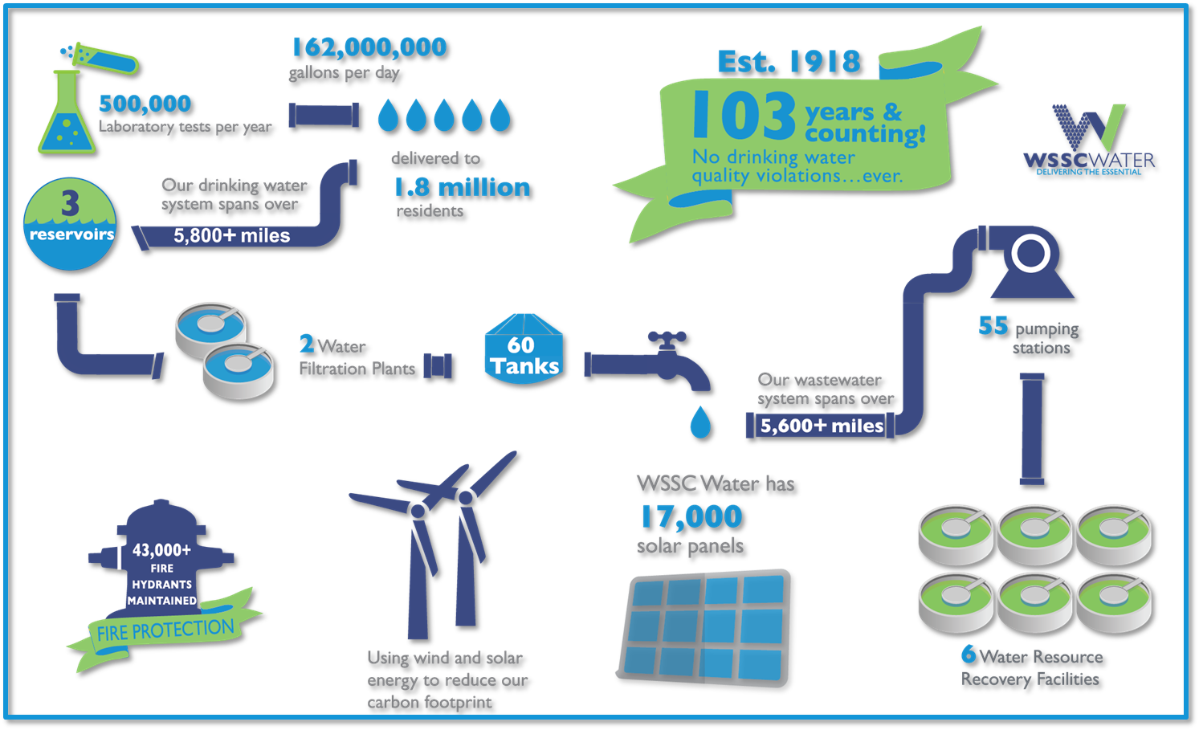
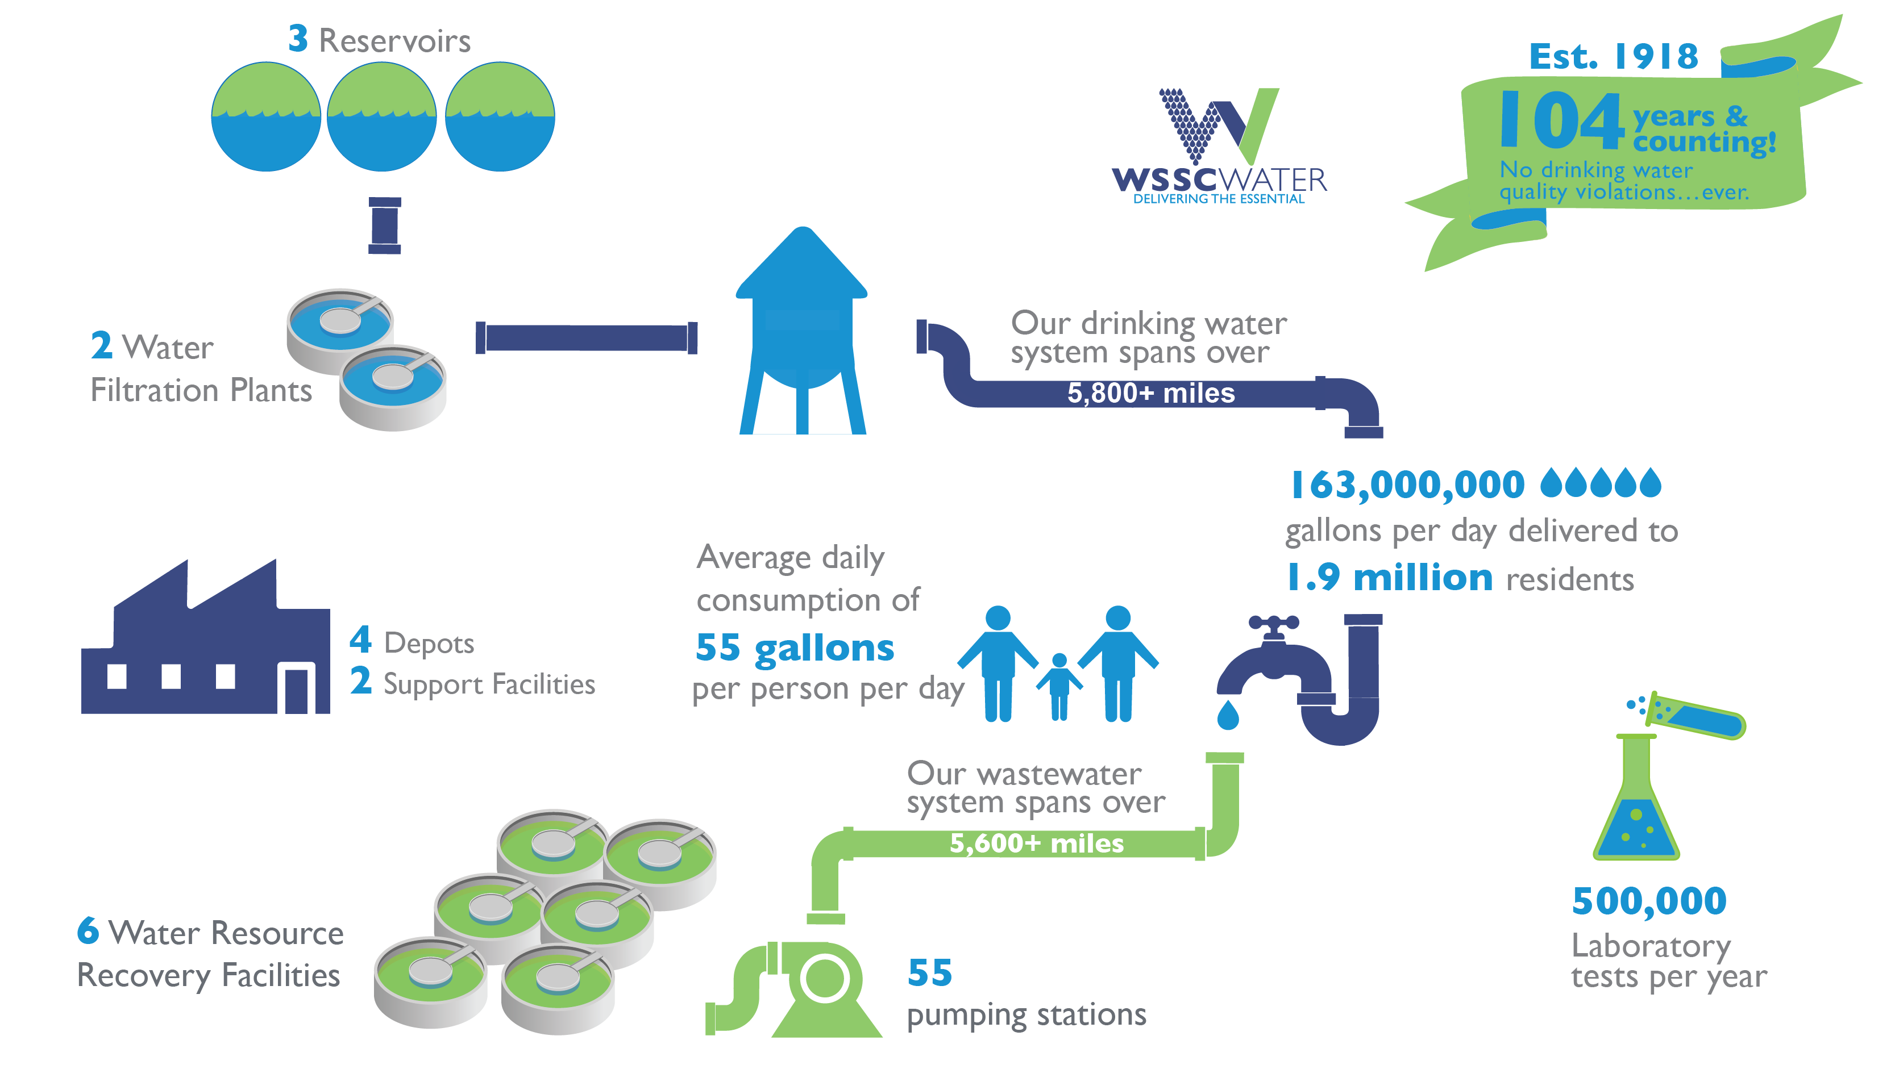
WSSC Water Overview

Slide 6
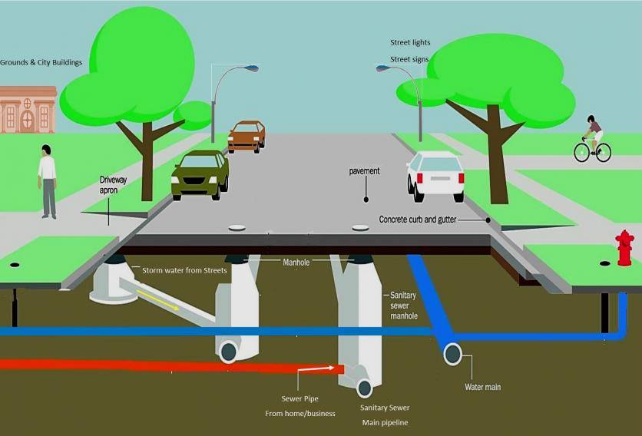

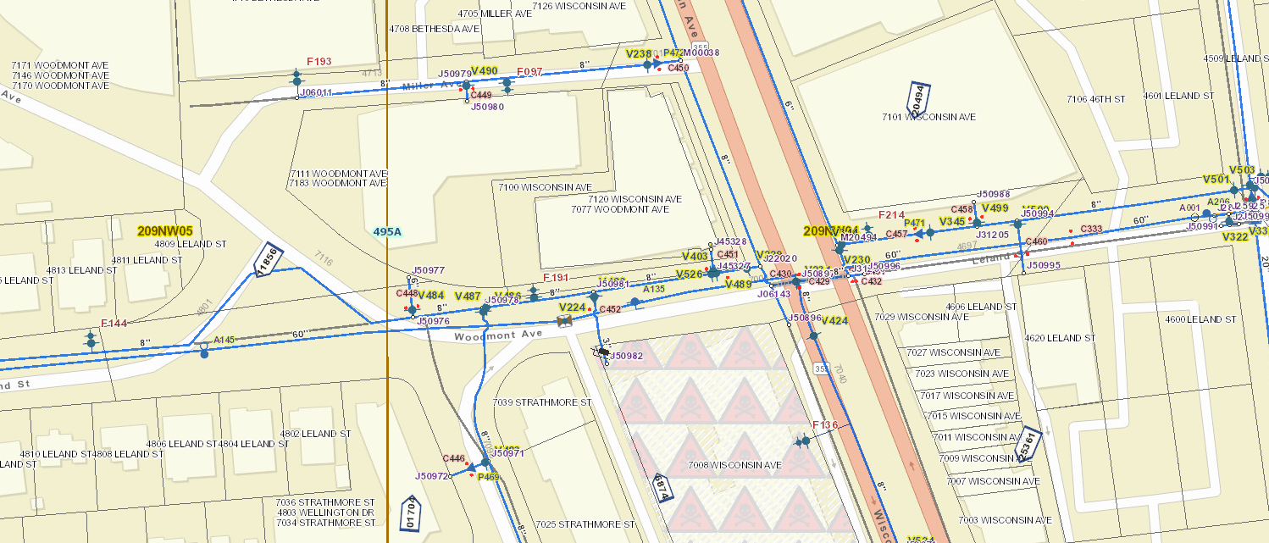
Project Overview
WSSC Water is strategically replacing and rehabilitating our aging infrastructure throughout our service area to enhance service, safety, and reliability for our customers.
WSSC Water coordinates with local and state agencies, adjacent development and other adjacent utility owners for all planned work to avoid potential conflict and minimize disturbances to the neighborhood.
Project Goal: Replace 55-year-old inoperable 48” valve on 60” PCCP water transmission main.
The next working valves in each direction are over a mile away.
Gas main
Water Transmission Main

Slide 7
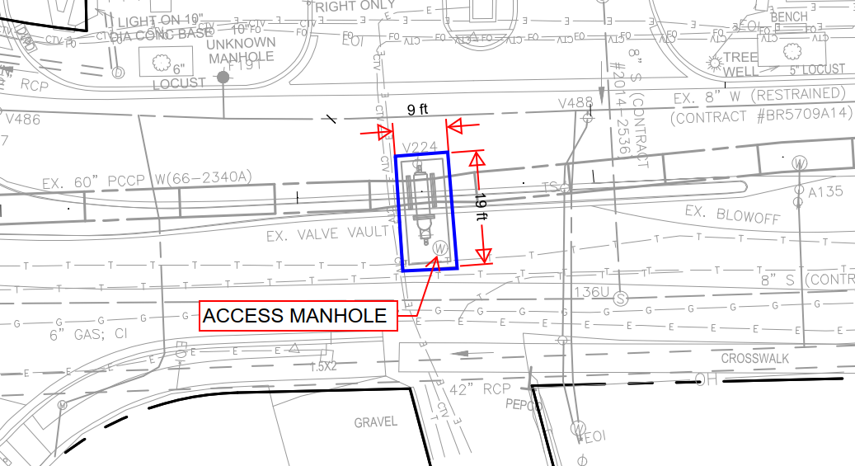
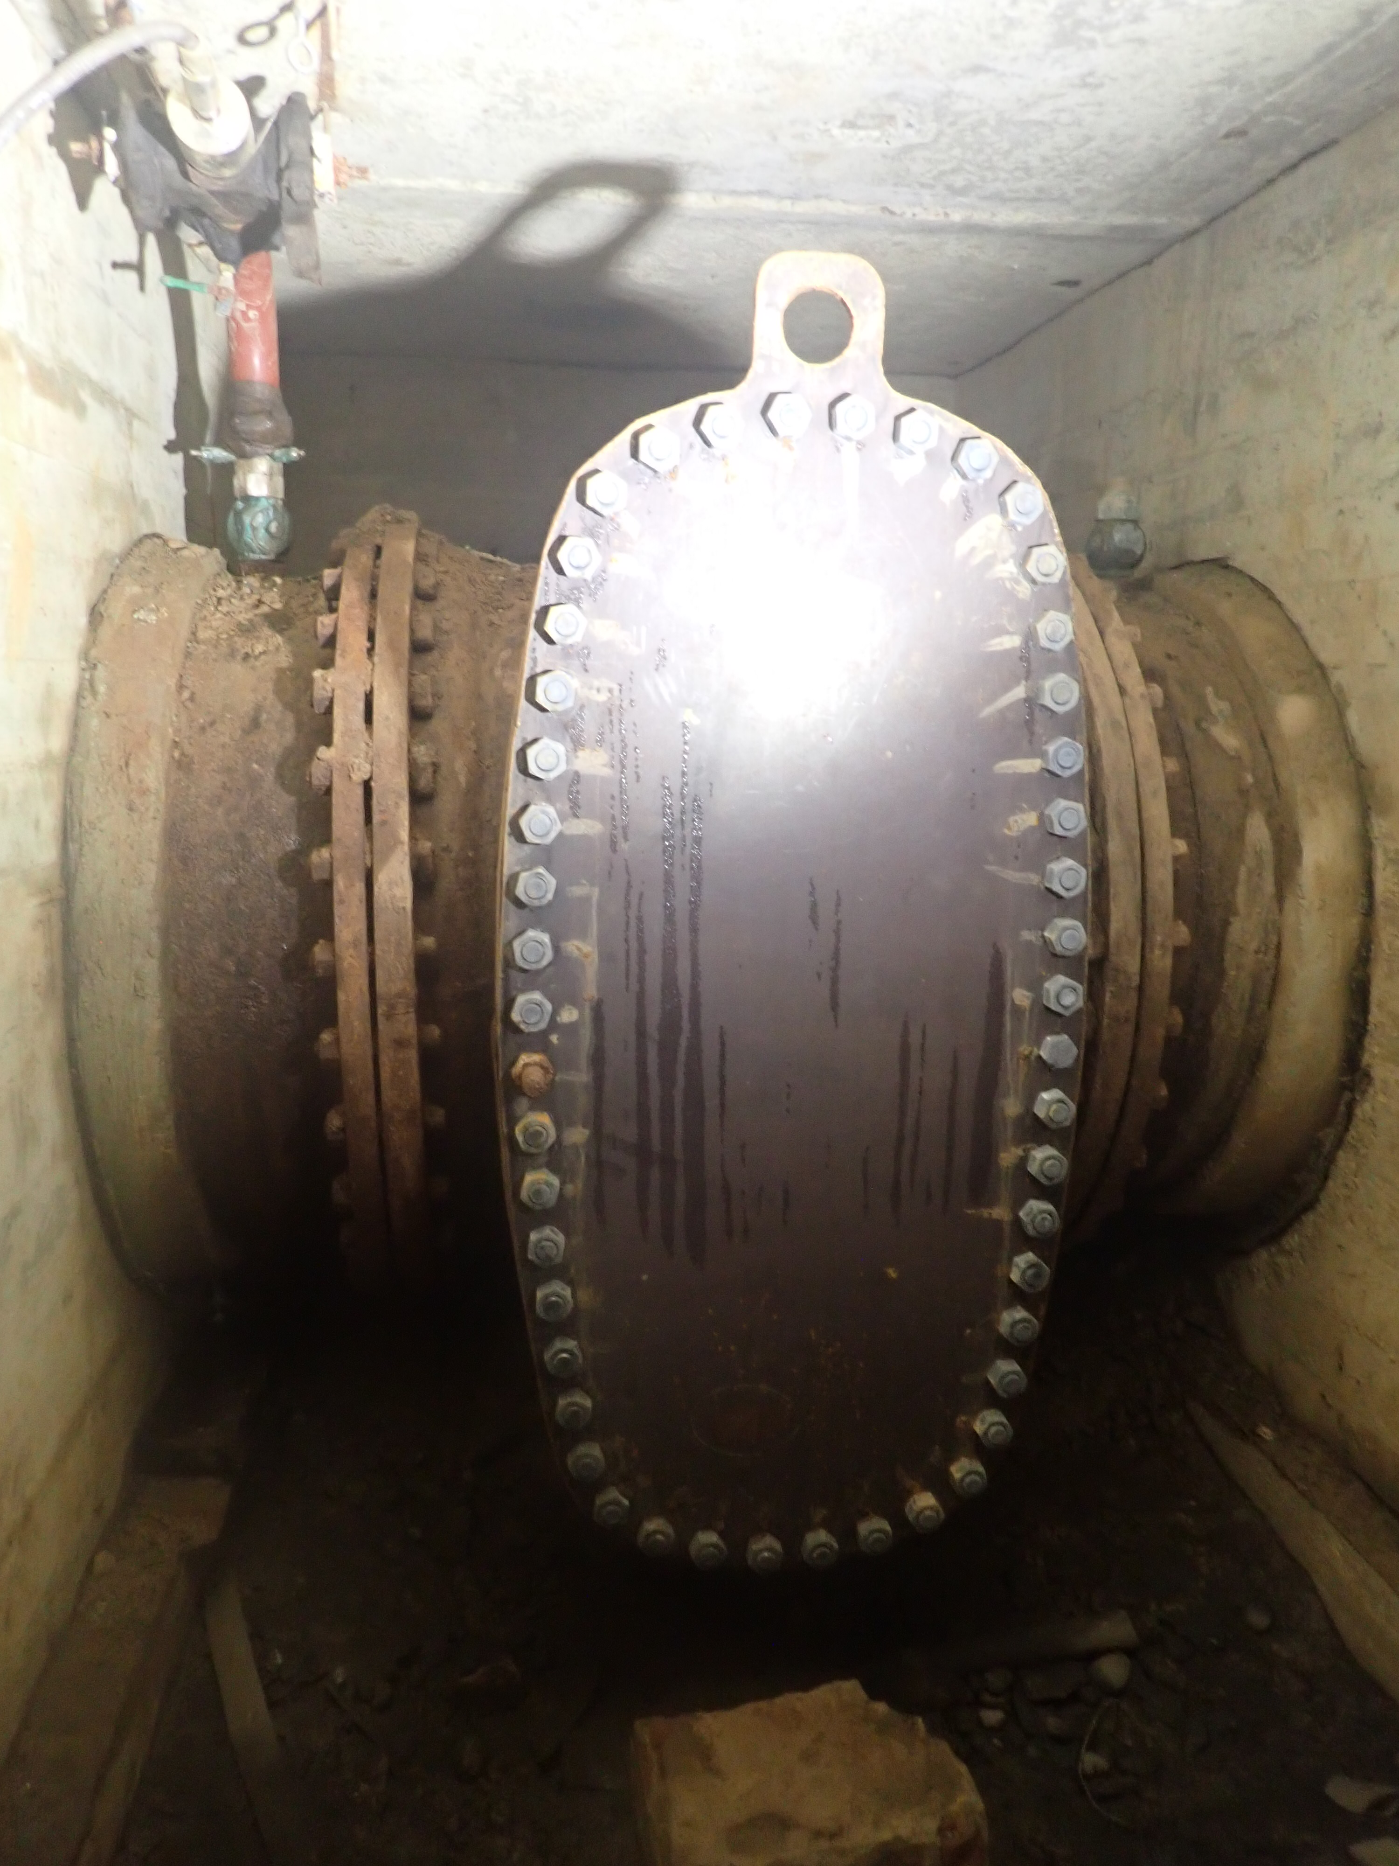
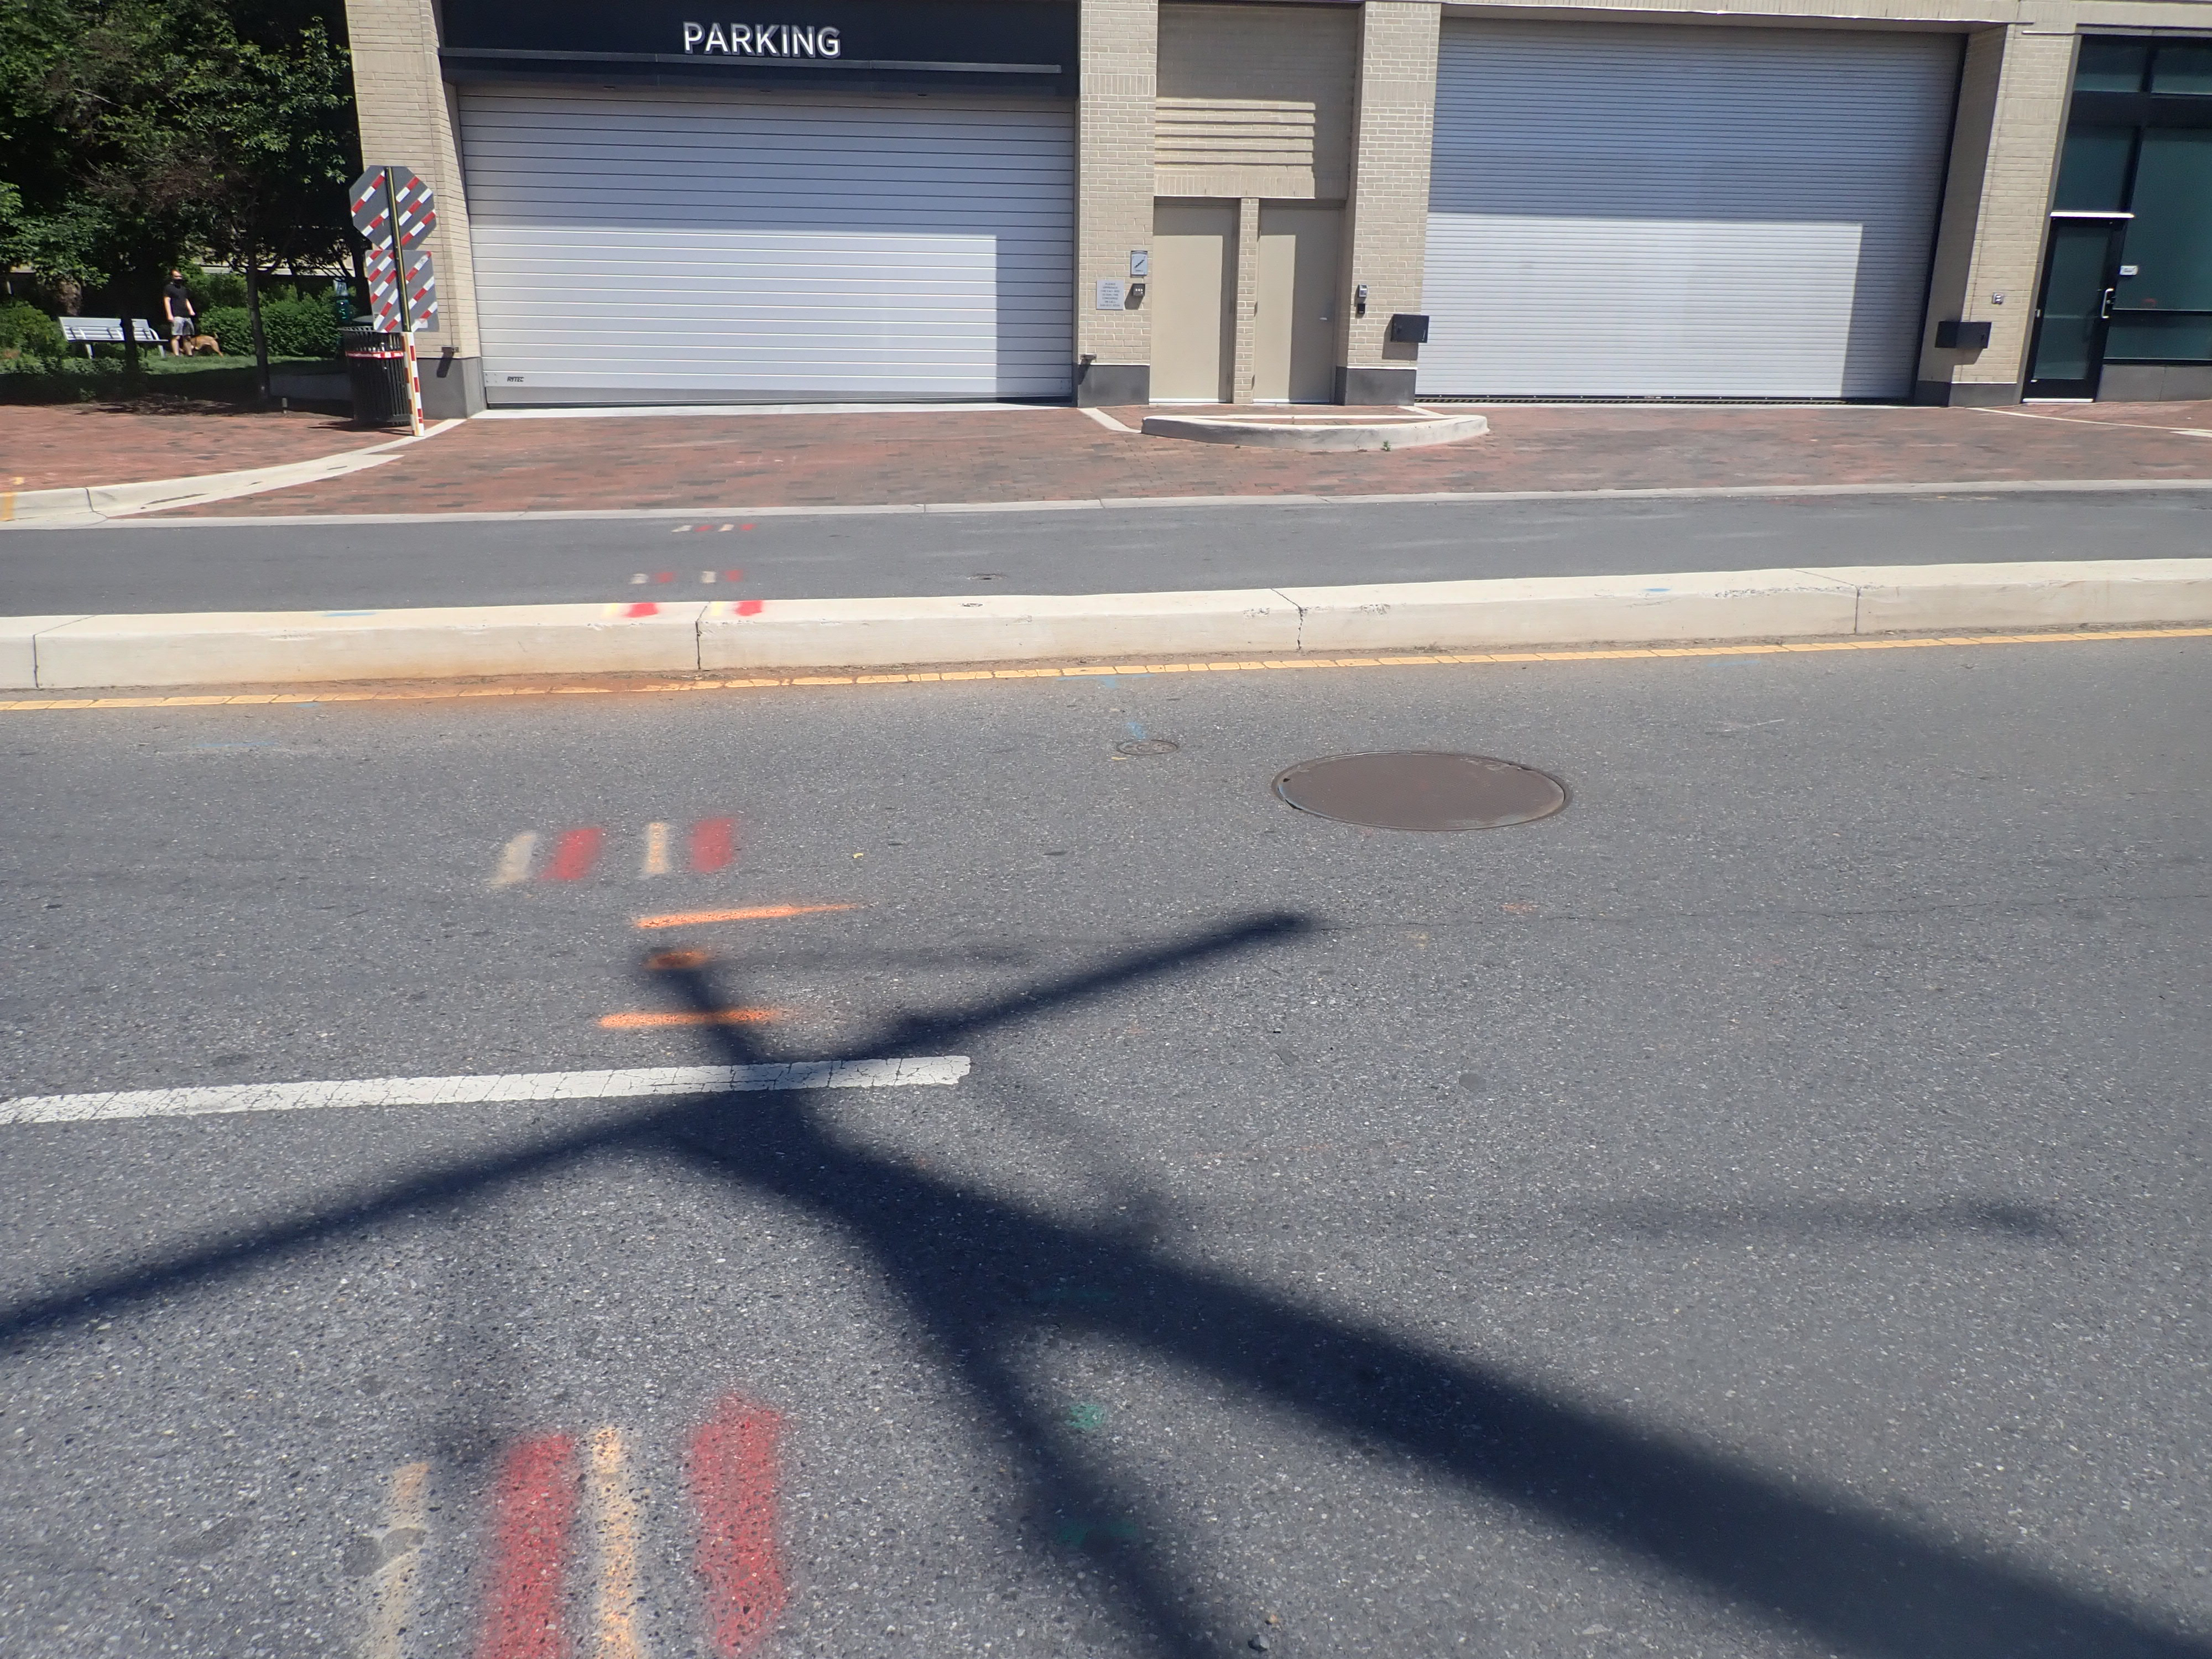
Overview, Cont’d.
PARKING GARAGE
Existing Valve located below Woodmont Avenue in a concrete vault approx. 19’L x 9’ W x 10’ D
Vault is accessed via manhole in Eastbound Lane of Woodmont Ave
Existing valve and vault to be removed and replaced with new pipe section
Replacing the existing valve and pipe will increase system control of critical infrastructure and remove constriction from 48” valve
WOODMONT AVE
ACCESS MANHOLE
Notes:
Existing valve does not operate, and existing vault is too small to permit maintenance and replacement of valve components within existing structure. The access lid is also within a travel lane of eastbound Woodmont Ave, making access more dangerous for WSSC maintenance personnel

Slide 8
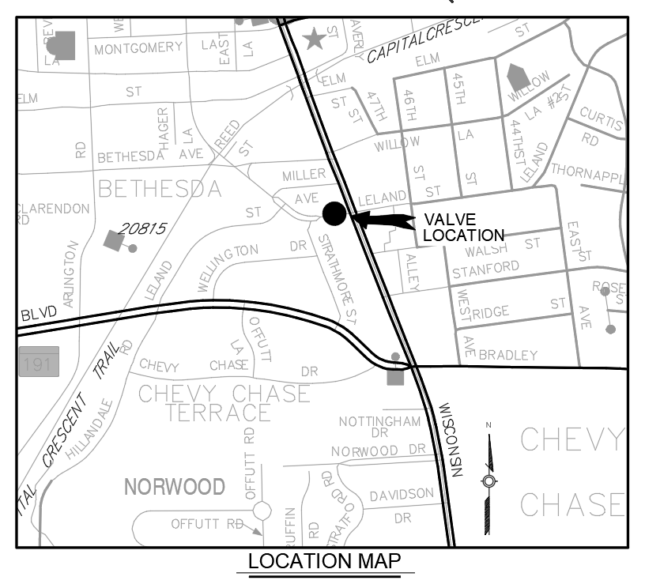
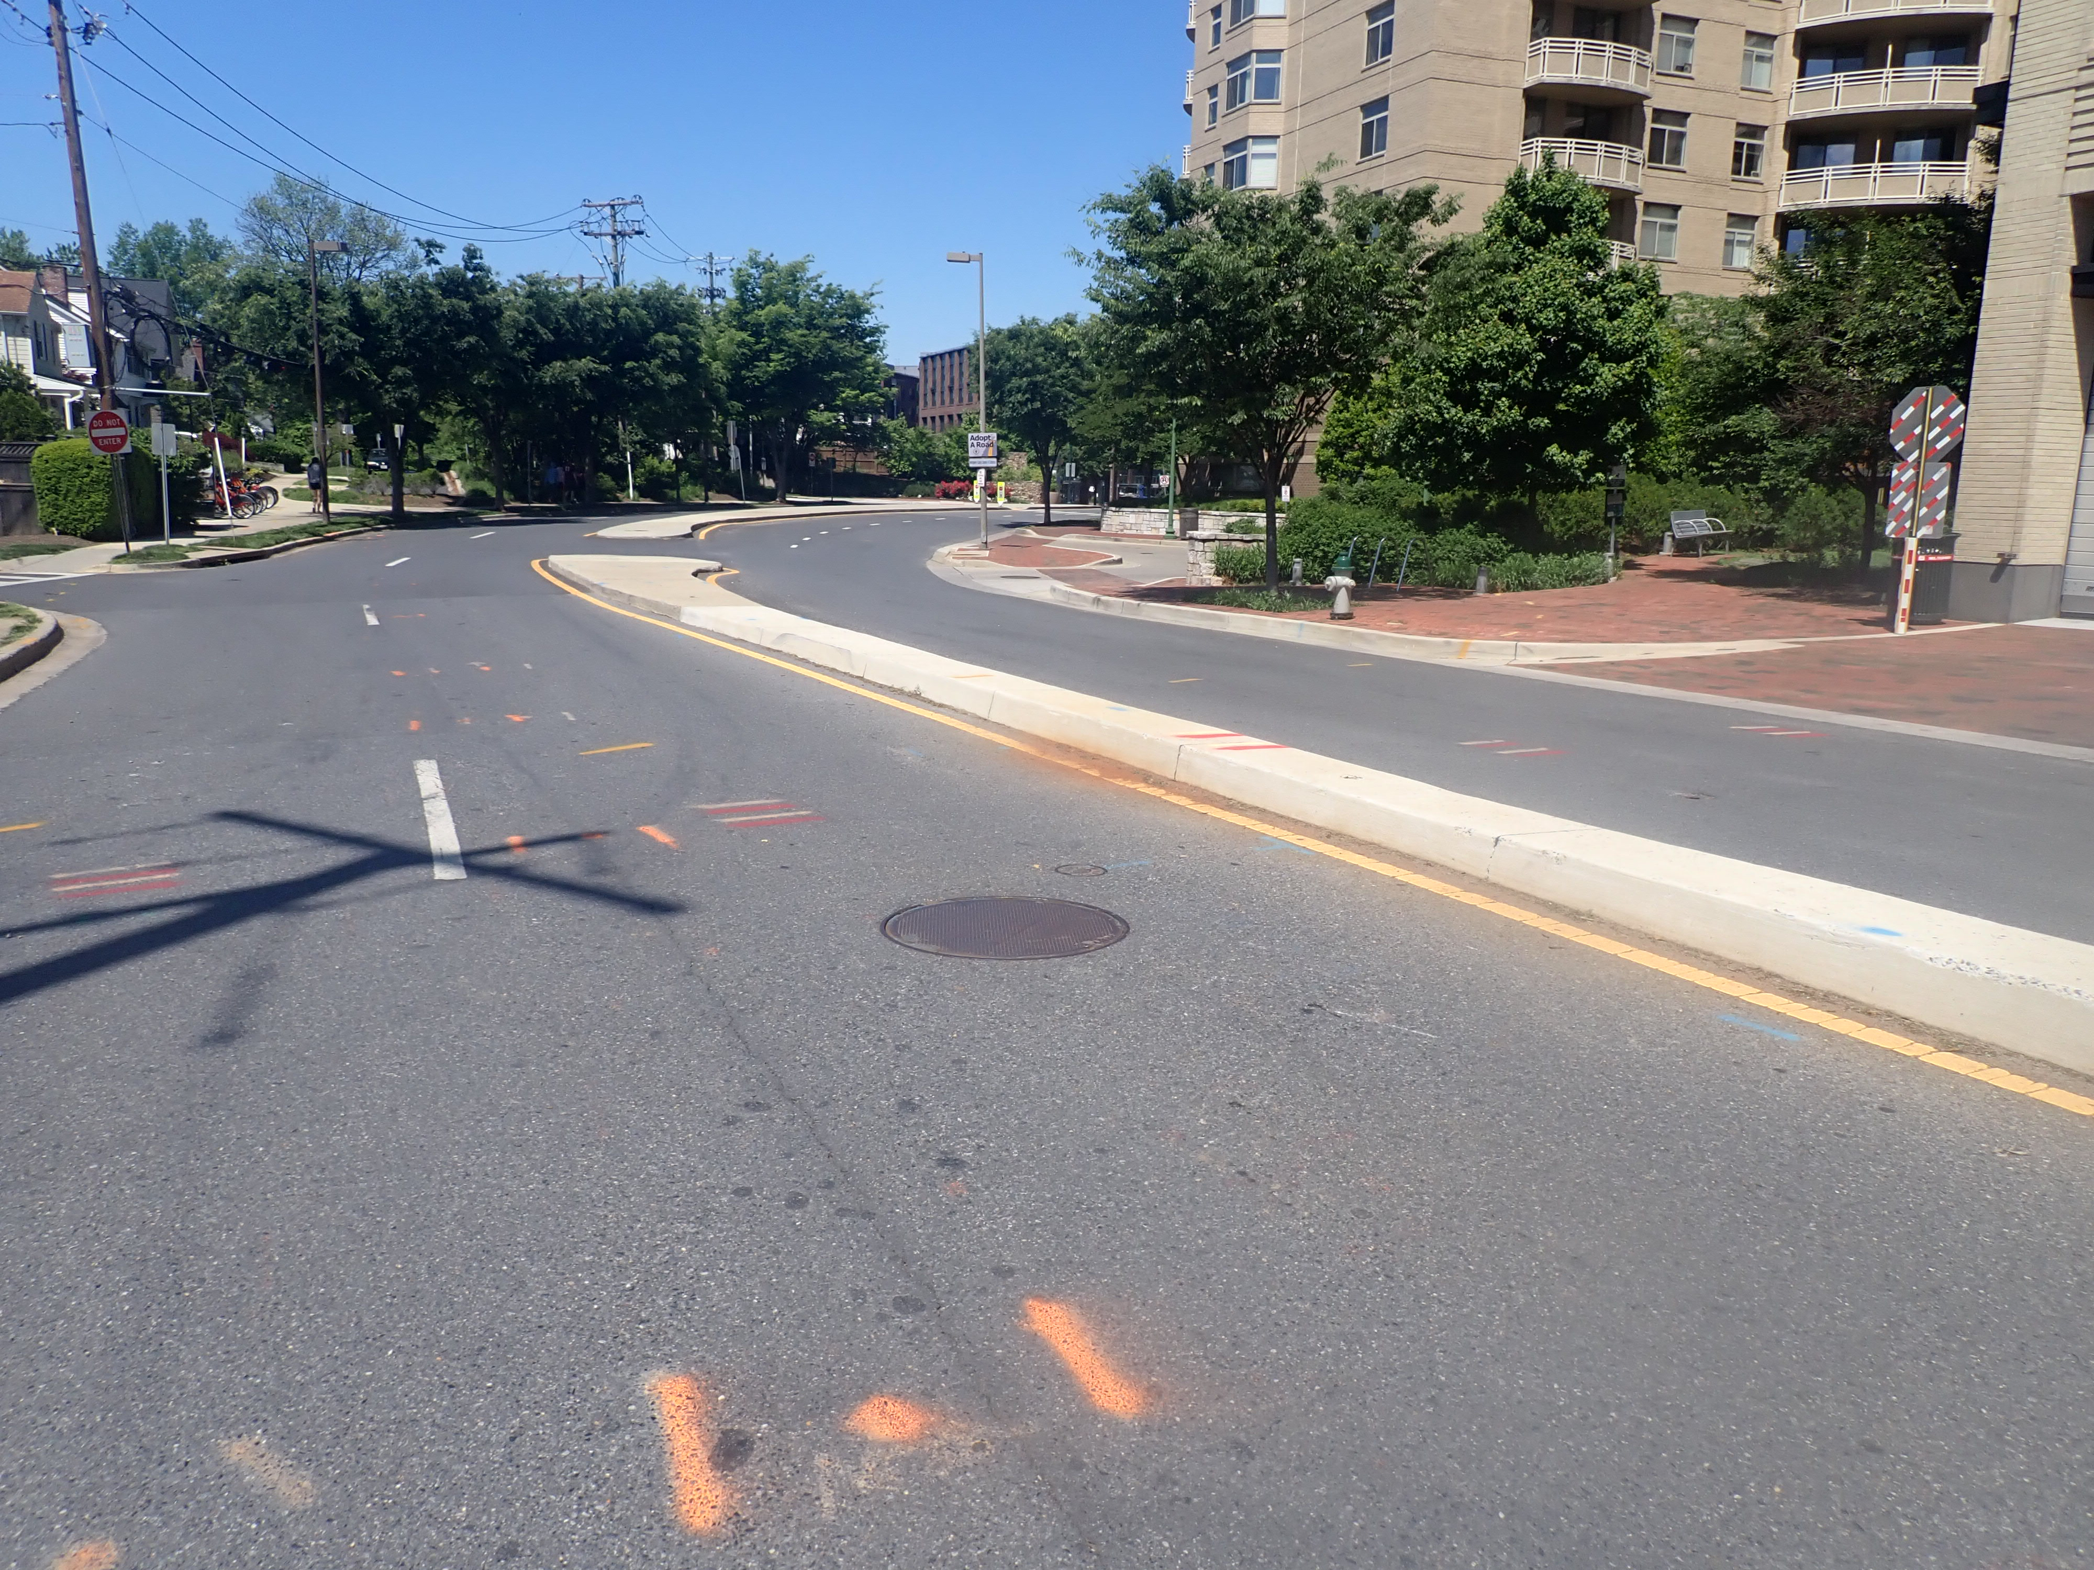
Location Options
Valve is critical to control of water in WSSC’s system
Existing 48” valve, vault and segment of pipe will be replaced and new 60” valve, concrete vault and 60” pipe will be installed
Three options were considered for the location of the new vault
  Option 1: Relocate to Pocket Park
  Option 2: Relocate to Leland St
  Option 3: Same Location
OPTION 3
OPTION 2
EX.
OPTION 1
EX. VAULT LOCATION

Slide 9
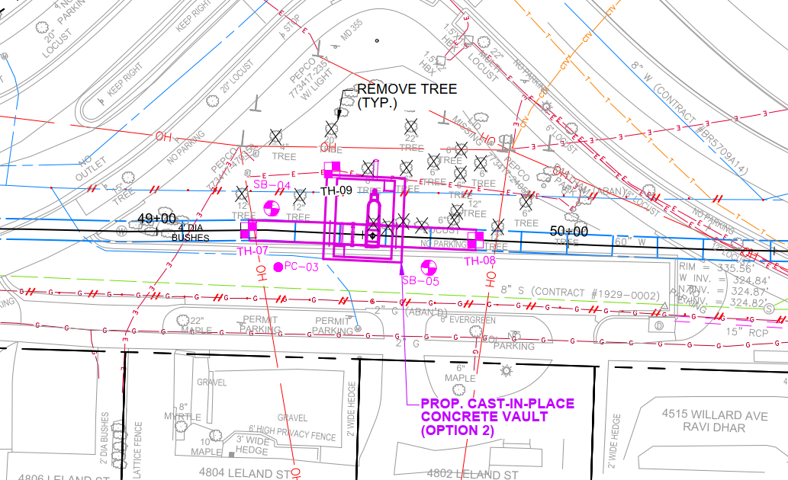
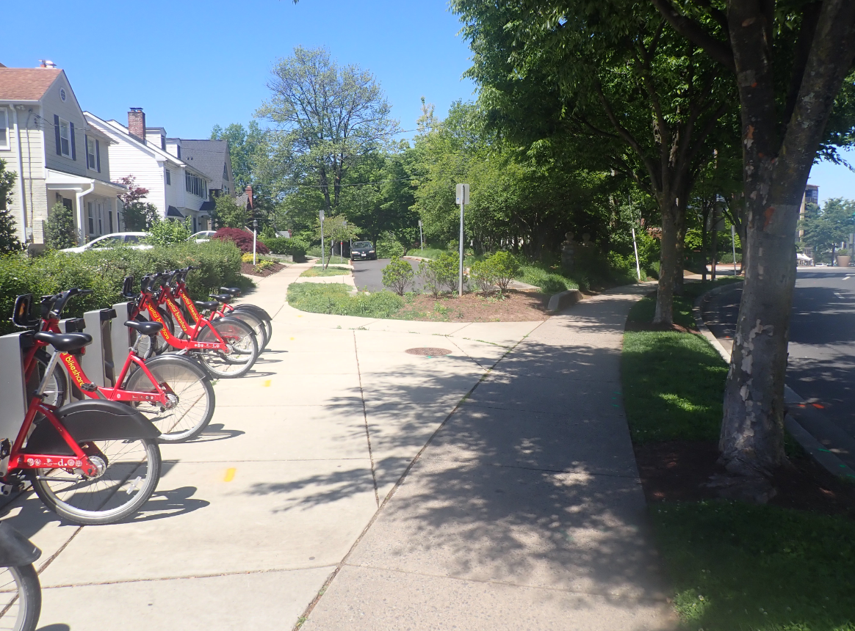
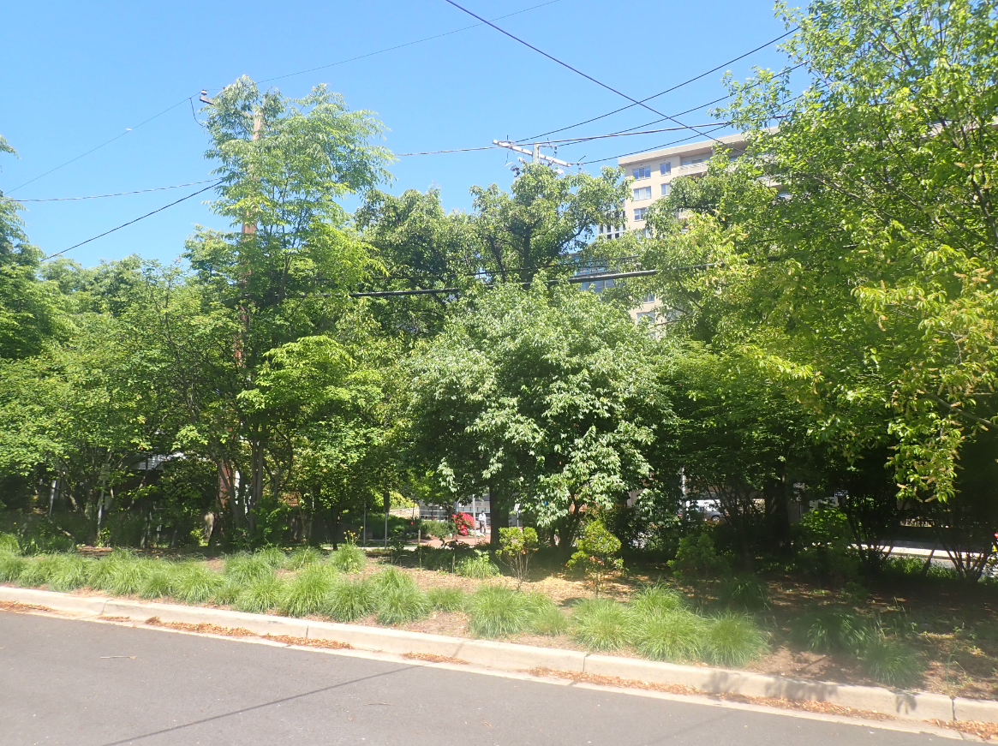
Option 1 – Relocate to Pocket Park
Remove Existing Vault and replace section with new pipe.
Relocate new vault west to Eastham Park
Pros:
  Traffic Impacts Reduced
  Vault Access Outside Roadway
Cons:
  Adjacent Overhead Utilities
  Crane Access
  Impact to Adj. Houses
  Tree Removal
  Two Construction Sites
LELAND STREET
WOODMONT AVE
Notes:
Impacts: Restricted ingress/egress due to construction activities and footprint, heavy construction equipment and excavation within 50 feet of homes, removal of most trees and significant utility relocations needed for construction. Utility relocation (OH electric and telephone) would extend construction duration/disturbance significantly, and the existing valve on Woodmont Ave would still need to be removed and replaced with new piping – two separate construction sites.

Slide 10
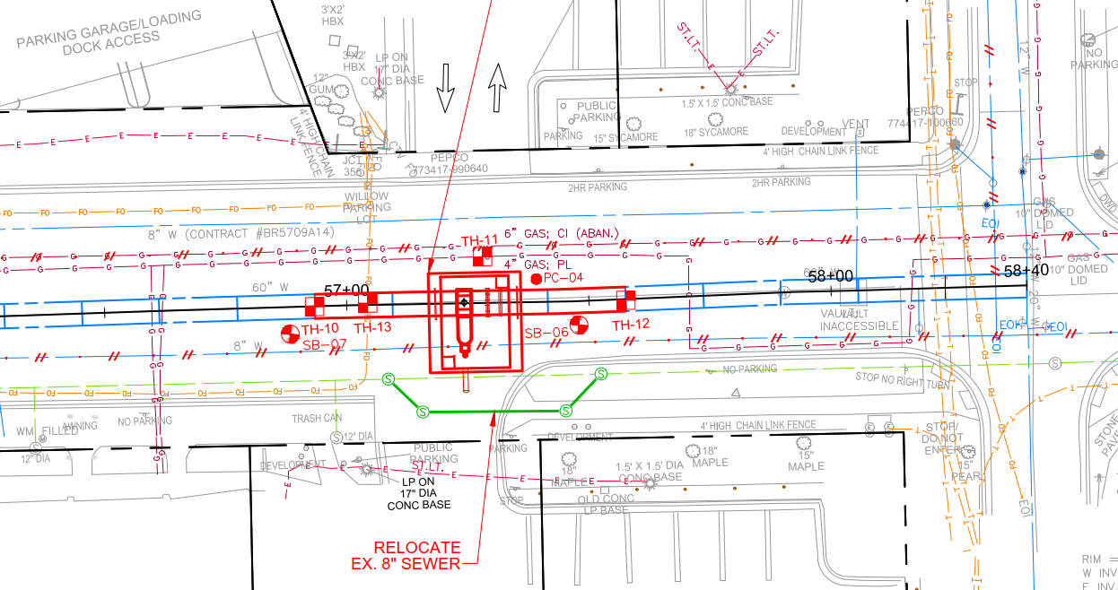
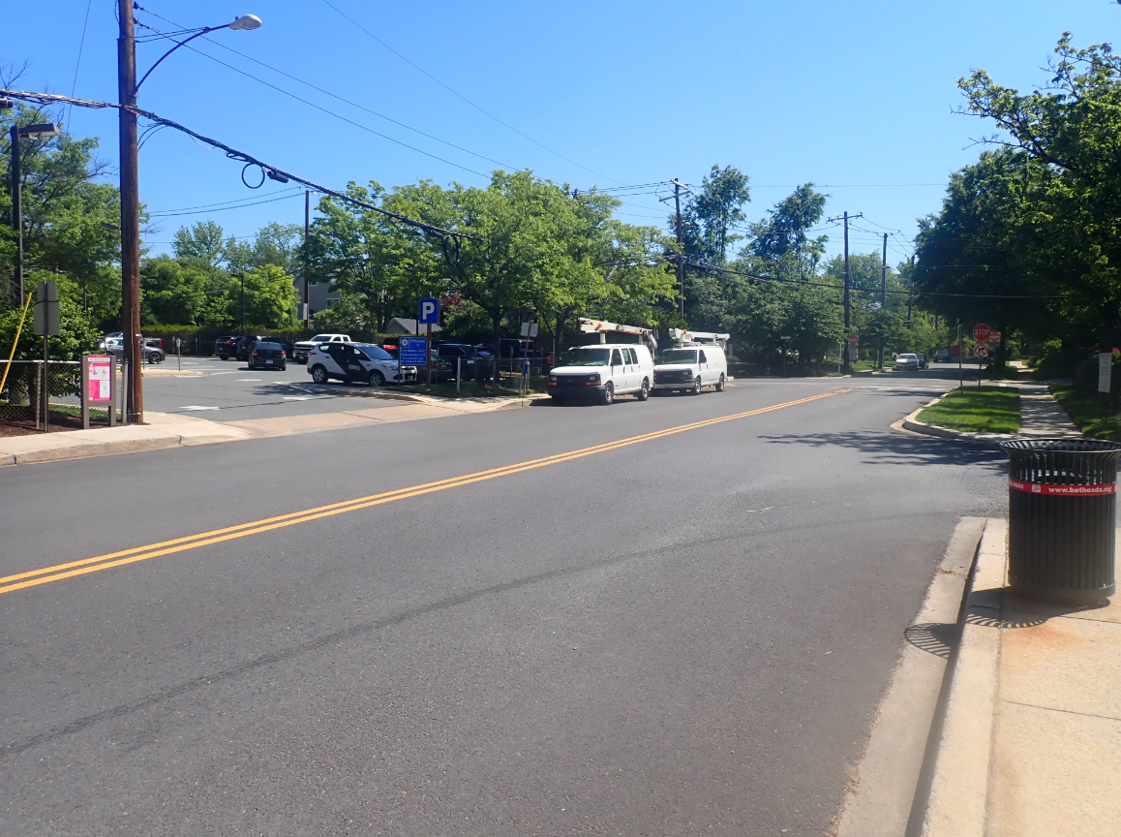
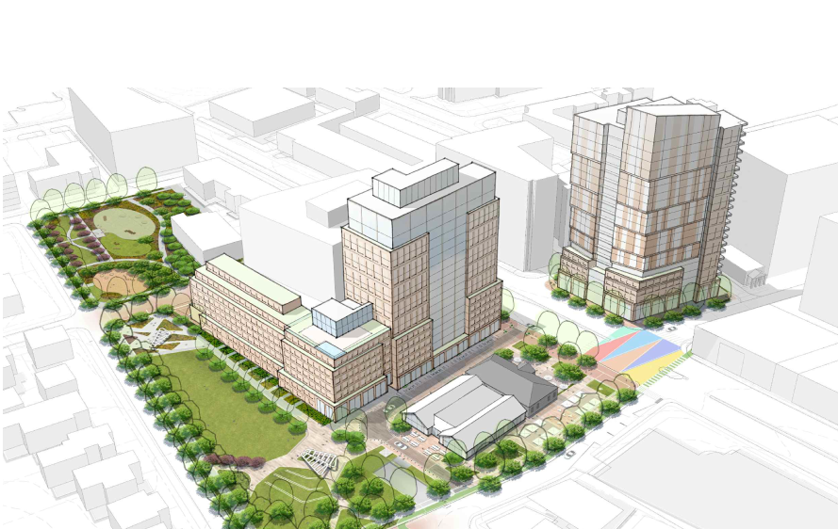
Option 2 – Relocate to Leland Street
Remove Existing Vault and replace section with new pipe.
Relocate new vault east to Leland Street
Relocate ex. 8” sewer
Closer to single family residences
Pros:
  Reduced impact to Woodmont Ave
  Easier Maintenance of Traffic
Cons:
  Adjacent Construction
  Two Construction Sites
  Vault Access is roadway
  Location not preferred by County
LELAND STREET
46TH STREET
Notes:
Potential impacts to Washington Gas pipeline that would require relocation, also requires relocation of a sewer pipeline. MOT would still require a road closure, but there is less traffic on this block and would result in less disruption to traffic. The existing valve on Woodmont Ave would still need to be removed and replaced with new piping – two separate construction sites resulting in greater overall disturbance and construction duration. No way to avoid some construction on Woodmont Ave at existing valve location.

Slide 11
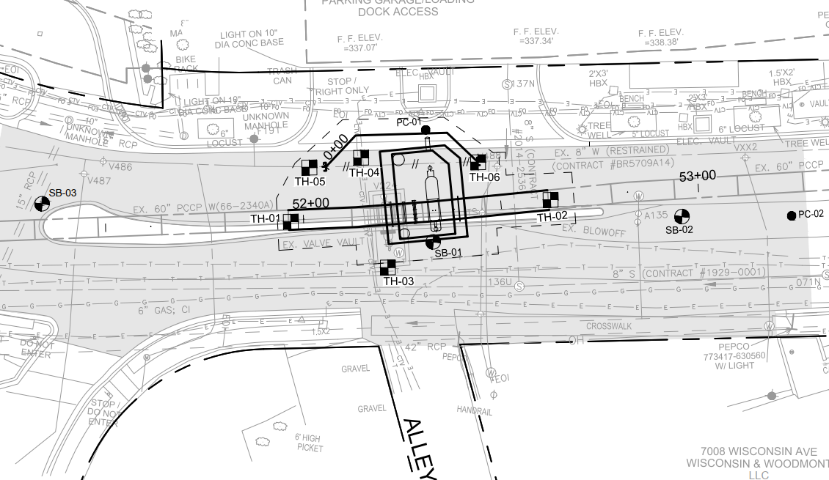
Option 3 – Replace at Same Location
Remove Existing Vault and replace in same location.
Relocate Ex. 8” Water to accommodate the new vault
Pros:
  One Construction Site
  Shortest Construction Duration
  Minimal Impact to Adjacent Utilities
  Minimal Environmental/Community Impacts
Cons:
  Intensive Maintenance of Traffic
  Vault Access in roadway
WOODMONT AVE
STRATHMORE ST
Notes:
Single construction site. Has the greatest impact to traffic, but also reduces overall construction disturbance/footprint and allows for expedited construction at a single location. Has the least impact to single family homes.

Slide 12
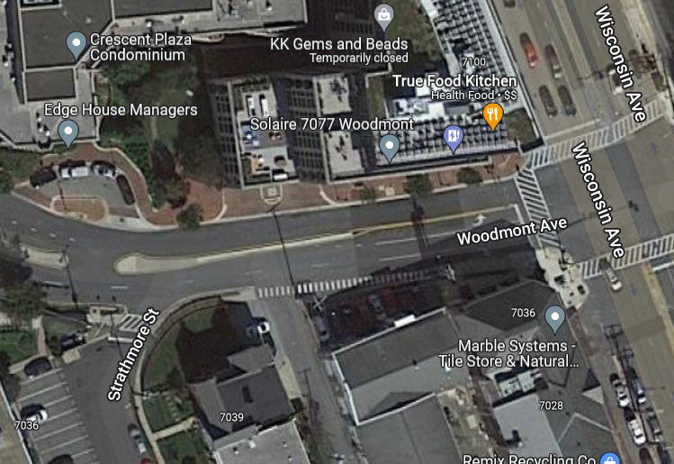
Ranking and Selection
Evaluated each option using weighted ranking of criteria such as:
  Impacts to community (residential & commercial)
  Environment/Aesthetics
  Construction Duration/Footprint
  Permitting Stakeholder Preference
Best Option: Option 3 – Same Location
  Minimizes construction footprint
  Preferred by County & Town of Chevy Chase
  Least impact to residential homes
  Shortest Construction Duration (single site)
Notes:
Options that have less impact to adjacent residential/commercial neighbors, with reduced environmental impacts and are preferred by Stakeholders (County, SHA, Town of Chevy Chase) and have shorter construction disturbance and duration score more favorably.

Slide 13
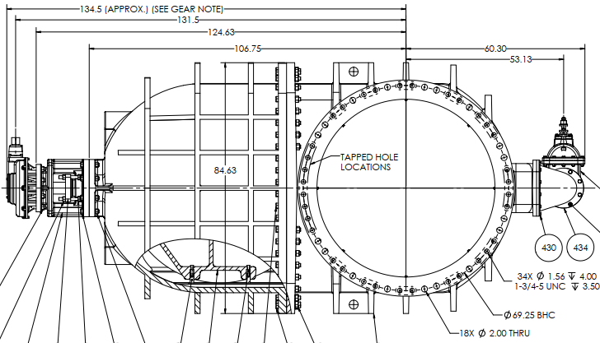
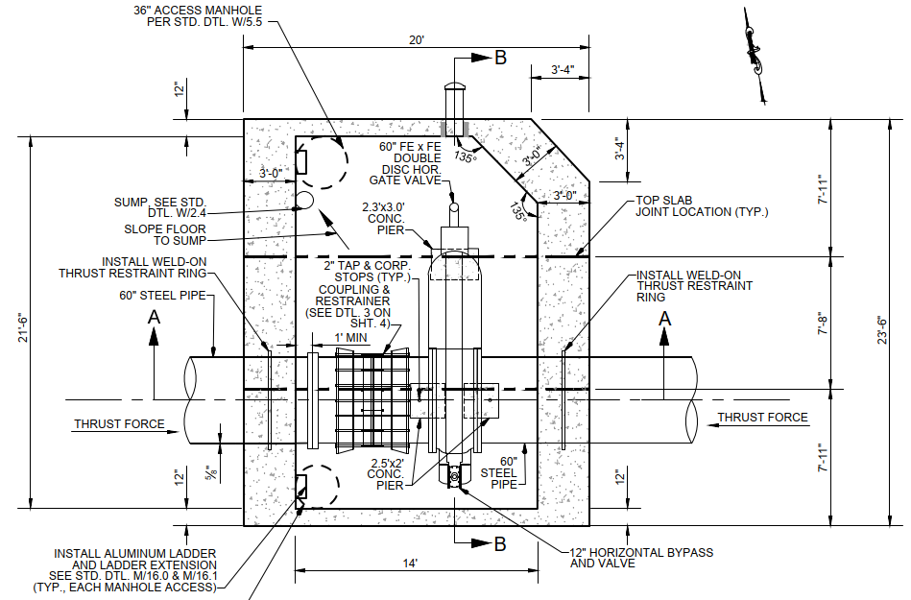
The New Valve
New 60” valve will be approximately 14’ L x 3.5’ W x 9’ D and weigh 27,000 lbs.
When closed valve will receive approximately
620,000 lbs. of force
Large, cast-in-place concrete vault needed
to restrain valve and resist movement
Valve Vault will be approximately the size
of a 2-car garage with dimensions of
23.5’ L x 20’ W x 14.5’ D
Roof slab will be precast panels to reduce
construction time in field
Notes:
Vault must be cast in place – vault required for replacement valve is too large for precast construction, and to restrain valve and prevent movement, the new steel pipe must be embedded in the concrete walls of the structure. A precast structure cannot accommodate restraint of the valve at this particular site, and other options for pipe restraint would require significant utility relocation that would add months to the construction duration.
Precast panels will be used for the roof slab; ideally suited for this type of installation. This saves about 1 month of construction time.

Slide 14
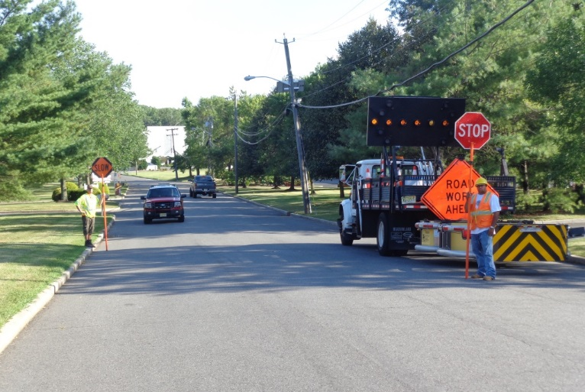
Traffic Control and Property Access
Construction will require temporary changes to traffic patterns
  Traffic will be managed to minimize community disruptions to the maximum extent practicable
Access will be maintained to homes, businesses and apartments during construction
  Access into homes is NOT required
  Access onto private property is generally NOT required
  The 7077 Woodmont Ave parking garage will be accessed from Woodmont Avenue and the loading dock will be accessed from Wisconsin Avenue with coordination with the Construction Team
Parking restrictions
  WSSC Water will provide 48-hour advance (denoted by “No Parking” signs) notice prior to any parking restrictions
  Any vehicles that have not been removed from the designated area will be towed to a nearby street at no cost to the owner.
Final restoration of sidewalks, roadways and landscaping will take place within 90 days of construction completion.

Slide 15
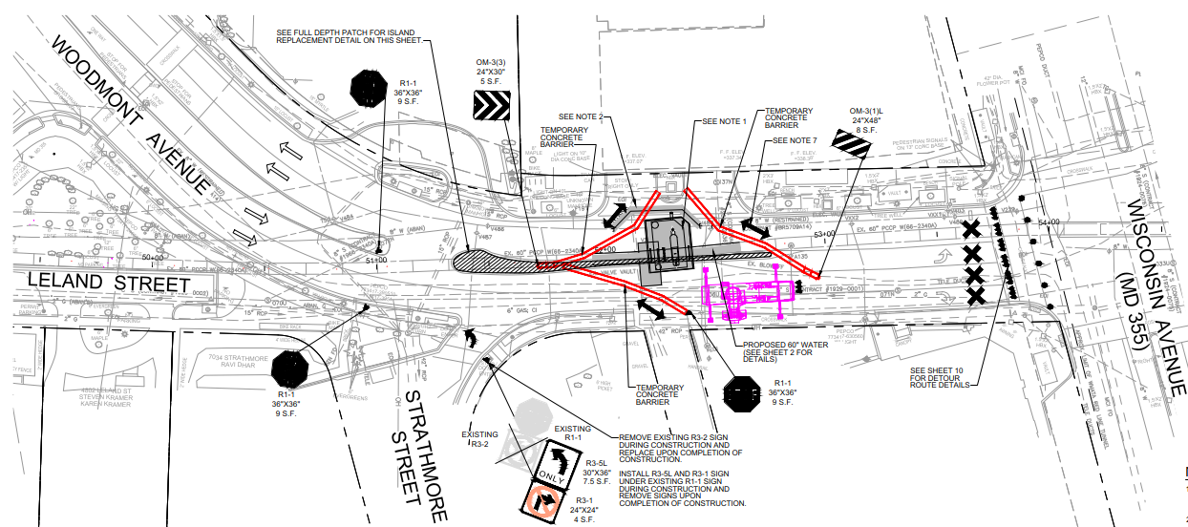
Traffic Control – Road Closure
Temporary closure of Woodmont Avenue at Wisconsin Avenue
  Open to local traffic only, no exit to Wisconsin Avenue
No turns onto Woodmont Ave from Wisconsin
  Access will be allowed to loading dock and parking garage at 7077 Wisconsin Avenue
Strathmore Street and Alley Left Turn Only (median to be removed)
Shortest construction duration
Maximizes public safety
Notes:
Full closure of Woodmont Avenue is the safest option for the traveling public and maximizes working area for construction, reducing construction duration

Slide 16
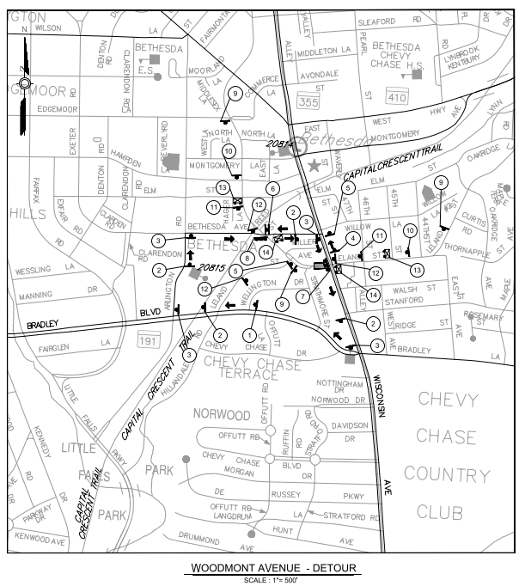
Traffic Detour
Impacted Streets
Woodmont Avenue
Turns from Wisconsin Ave (MD 355) to Woodmont Ave
Strathmore Street
Alley behind 7000 Wisconsin Ave
Leland Street (westbound to Woodmont Ave)
Notes:
Detour utilizes Bradley Blvd, Arlington Road and Bethesda Ave to direct traffic around work area back to Wisconsin Ave

Slide 17
Estimated Construction Schedule
CONSTRUCTION ACTIVITY | LOW DURATION (WEEKS) | HIGH DURATION (WEEKS)
Site Preparation, cut & cap existing 8" water | 0.5 | 1
Excavation for vault and pipe, sheeting and shoring | 2 | 3
Demo existing vault and PCCP pipe | 1 | 1
Install rebar cage, form vault floor and walls, install steel pipe and thrust rings at vault interface, pour floor and walls | 4 | 5
Concrete floor/wall cure time (sufficient to continue work) | 1 | 2
Install 60" valve and remainder of 60" steel pipe | 2.5 | 3
Backfill excavation, remove sheeting and shoring | 1 | 1.5
Set precast roof slabs and manhole/hatch risers | 1 | 1
Install relocated 8" water and reconnect | 0.5 | 1
Backfill roadway area to pavement subgrade, install asphalt pavement over vault/pipeline for travel lanes | 1 | 1.5
Weather Delays | 1 | 2
Total (Weeks) | 15.5 | 22
Total (Months) | 3.7 | 5.2
  Anticipated Start
  Summer 2024
  Anticipated Completion
  Fall 2024
  Anticipated Closure
  Duration
  16-22 Weeks
  Construction schedules are estimates and subject to weather delay

Slide 18

What to Expect During Construction
Anticipated Work Hours: Monday-Saturday, 7:00 a.m. – 7:00 p.m.
  Proposed extended work hours to reduce construction duration.
Construction activities may include:
  Field reviews and inspections
  Survey crews
  Test pits
  Construction crews and heavy machinery, including cranes
Reliable water and sewer service will be maintained during construction
  Short water shutdowns of up to 8 hours may be required
  Advanced notification (48-72 hours) of these shutdowns will be provided
Notes:
12 hour work days, 6 days a week, helps minimize construction duration

Slide 19
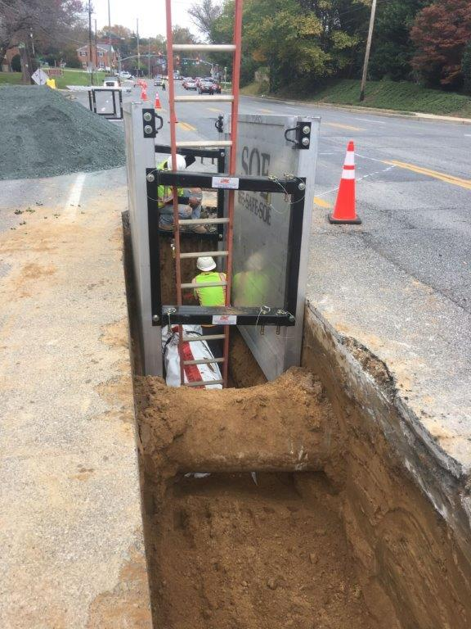
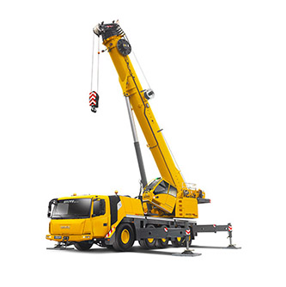
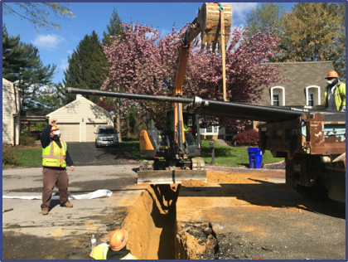
What to Expect During Construction
Open-cut construction method, which involves cutting and excavating a section of the pavement.
This construction method does create noise and dust.
Heavy-lift crane needed
SOURCE: GROVE CRANE

Slide 20
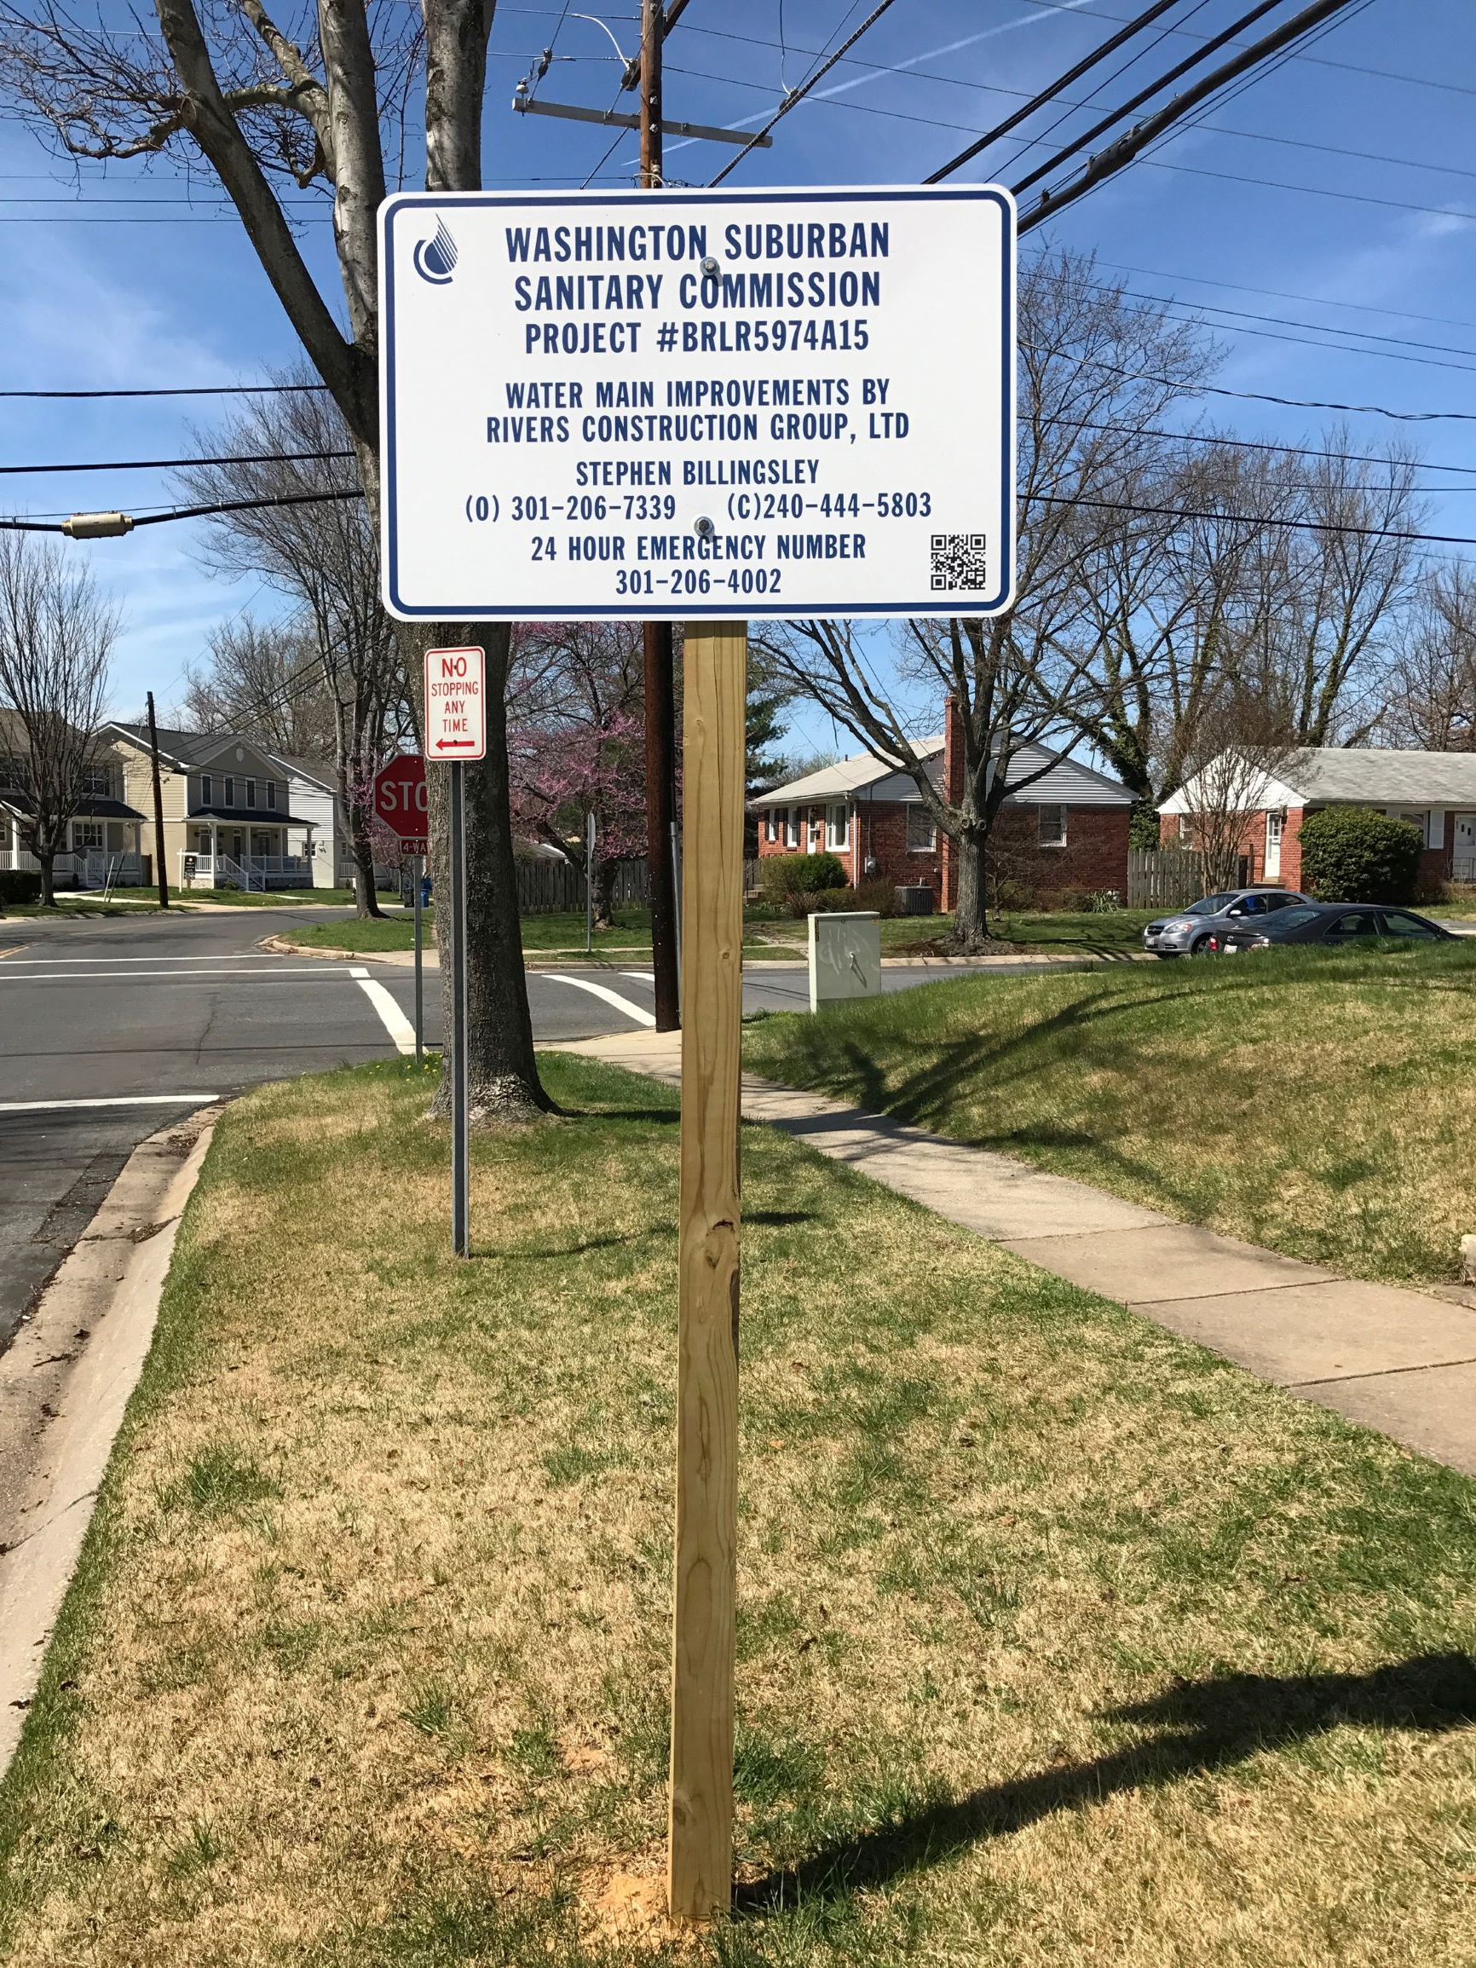
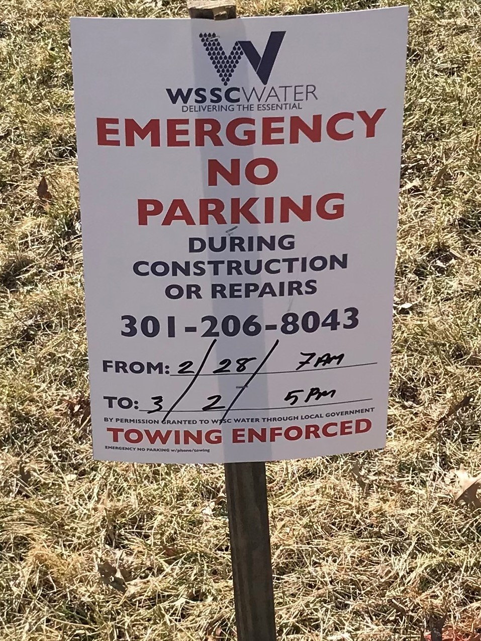
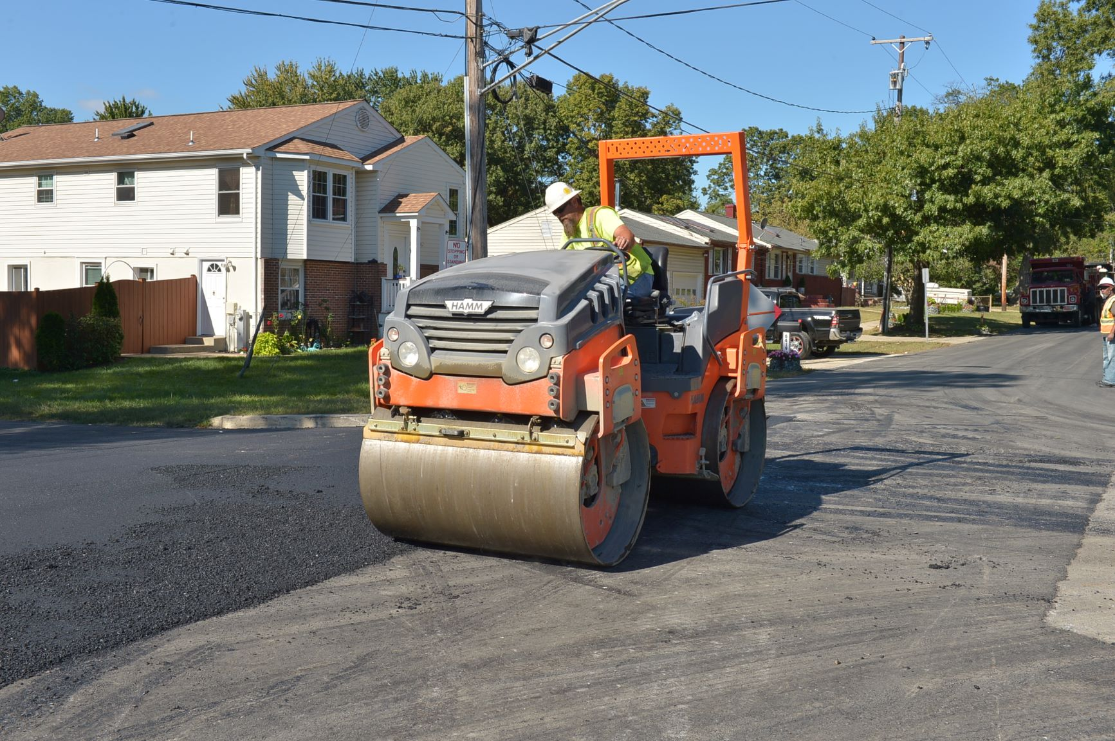
Signage and Restoration
Construction signs with contact persons will be placed throughout the project area
Projects completed during the winter months will be permanently paved and restored to their original state or better in the following spring.

Slide 21
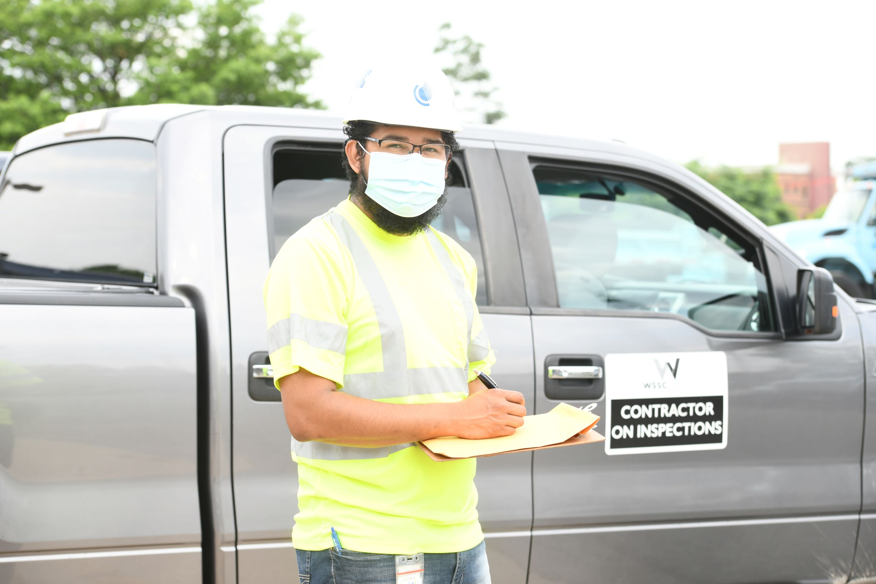
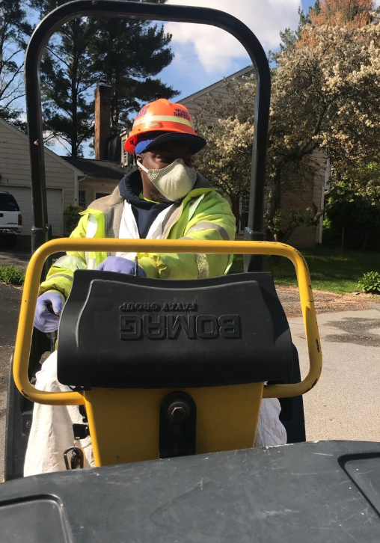
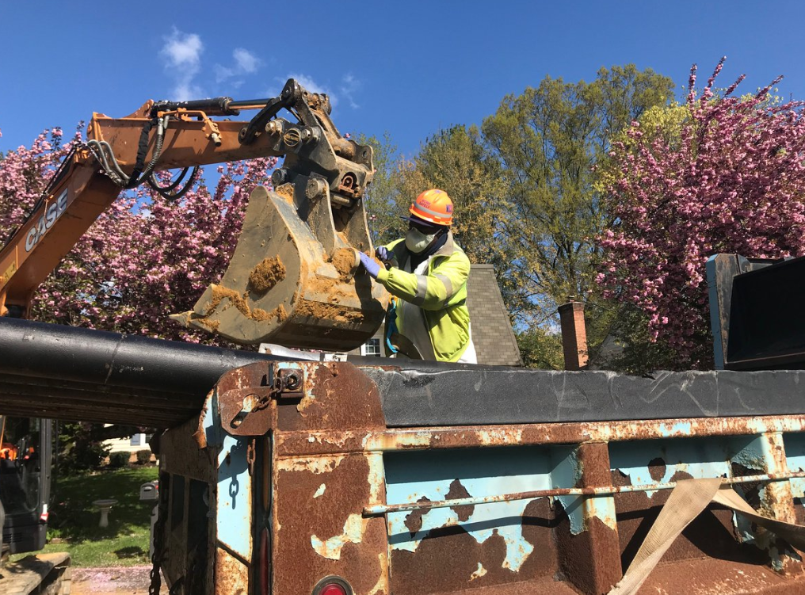
Operational Changes in response to Covid-19
WSSC Water has implemented protocols that align with recommendations from local, state, and federal public health authorities. ​
Working to minimize impact​
​
All WSSC Water employees and contractors are required to refrain from coming to work if displaying symptoms of COVID-19.
  We have implemented robust internal contact tracing and quarantine requirements. ​
Earlier notification to customers​ of water shutdowns

Slide 22
Project Summary
The existing 48” valve vault is inoperable and a public safety concern.
WSSC Water evaluated several sites to install a new valve and found same location replacement to be the best option.
Extensive traffic control will be necessary to remove the existing valve and pipe and install the new valve vault and pipe.
WSSC Water will coordinate work activities with property owners in the project area.
WSSC Water will restore all areas impacted by construction activities at the end of the project.
WSSC Water’s goal is to provide a reliable water system to customers.

Slide 23




Contact WSSC Water
Customer Service | Monday-Friday, 7:30 a.m. to 7:00 p.m.
  Phone: 301.206.4001 | 1.800.634.8400
  Email: customerservice@wsscwater.com
24-Hour Emergency Call Center
  Water Emergency, Sewer Emergency or Discolor Water
  Phone: 301.206.4002 | Email: emergencycallcenter@wsscwater.com
  Report a Problem: wsscwater.com/customer-service/report-problem
  Discolored Water: wsscwater.com/discoloredwater
File a Claim
  Phone: 301.206.7095
  Online: wsscwater.com/claims
WSSC Water Financial Assistance Programs
  Online: https://www.wsscwater.com/assistance
Customer Notification System Sign-Up
  www.wsscwater.com/cns, email and/or text alerts on work in your neighborhood

Slide 24

THANK YOU! QUESTIONS?

