Slide 1
Bi-County Municipal Townhall
Intergovernmental Relations Office
Monica Marquina, Government Affairs Director
July 18, 2024

Slide 2
WSSC Water Overview
Strategic Plan
CIP Investment and Impact on Municipalities
Finance
Project Outreach Timeline
Customer Assistance
Customer Advocate Contacts
Customer Service
IRO Contacts
Collaboration Opportunities

Slide 3
Municipal Introductions

Slide 4
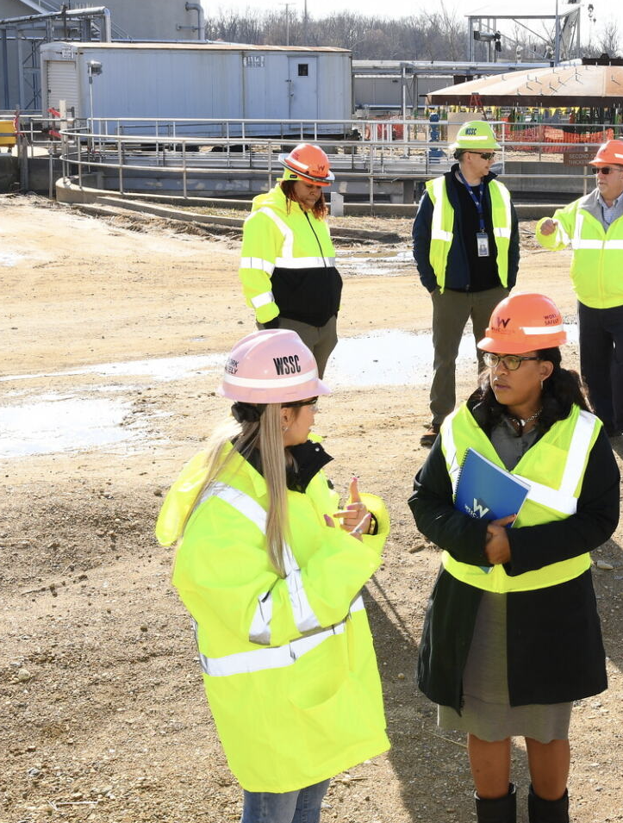
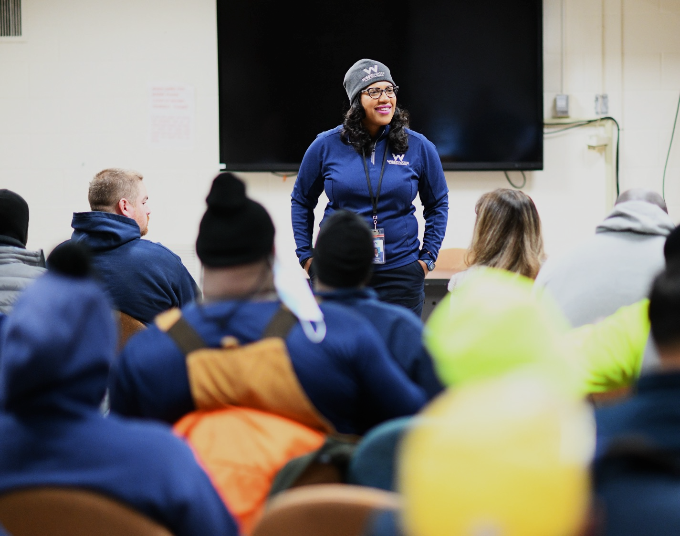
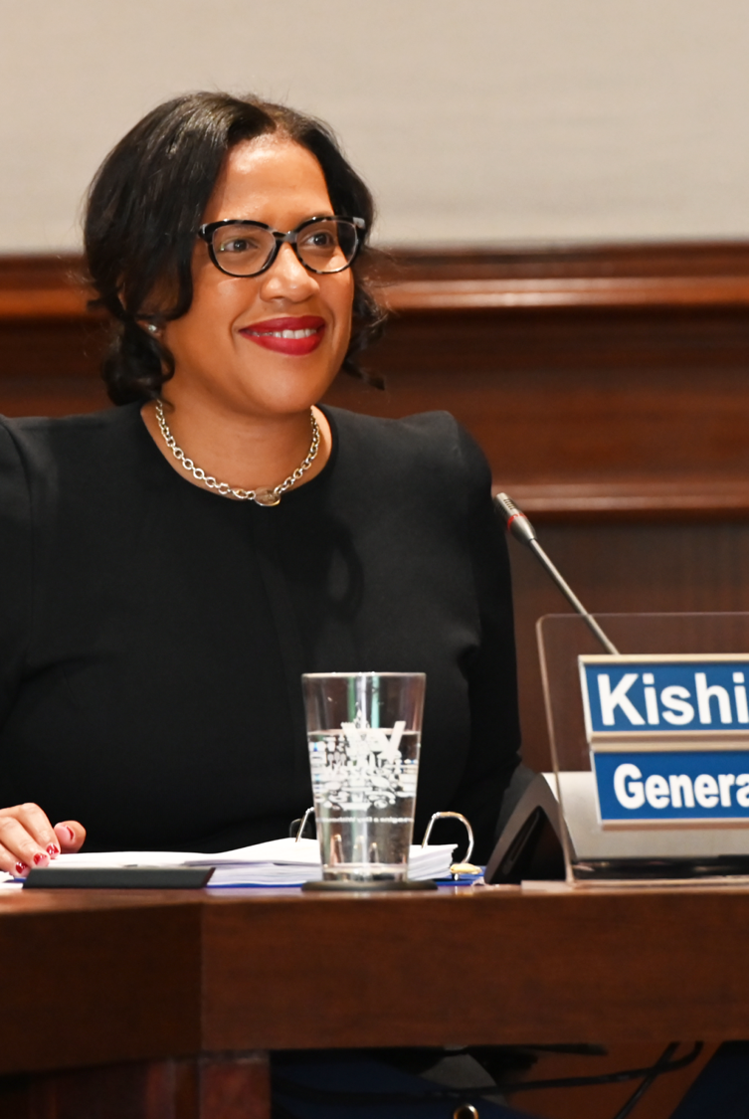
Kishia L. Powell
General Manager/CEO

Slide 5
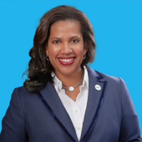
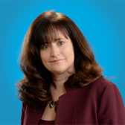
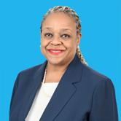
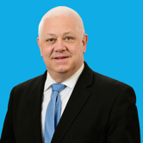
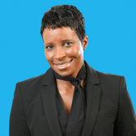
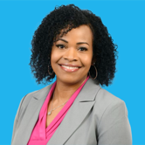
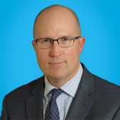
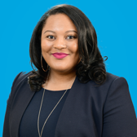
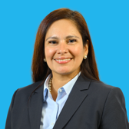
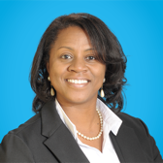

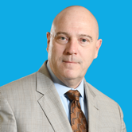
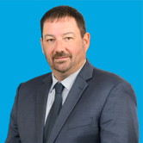
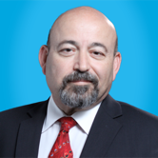
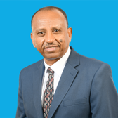
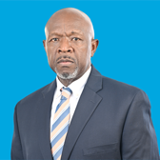
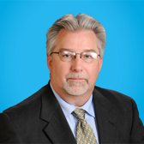
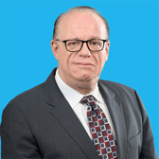
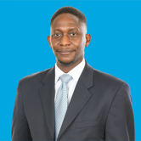
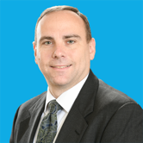
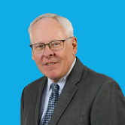
WSSC Water Leadership Team
Kishia L. Powell
General Manager/CEO
Amanda Conn
General Counsel
Nina R. Hickson
Chief of Staff
Bob Maloney
Performance &
Accountability Director
Michelle Romney
Chief Human Resource
Officer
Cristi Bickham
Deputy General Manager
External Affairs
Chuck Brown
Communications
& Community
Engagement Director
Courtney Edmonds
Office of Supplier Diversity
& Inclusion Director
Monica Marquina
Government Affairs
Director
Caprecia
Poole-Williams
Chief Procurement
Officer
David McDonough
Deputy General Manager
Mission Support
Joseph Bergstrom
Police and Homeland Security
Director (Acting)
David Gill
Chief of Health and Safety
Al Roshdieh
General Services Director
Aklile Tesfaye
Deputy General Manager
of Operations
Glen Diaz
Utility Services Director
J.C. Langley
Production Director
Eyad Mizian
Chief Engineer
Munetsi Timothy
Musara
Chief Financial Officer
John Curry
Customer Service Director
Thomas L. Kuczynski
Chief Information Officer
Notes:
As we continue building a strong workforce, we have added a new member to the Senior Leadership Team. Her name is Nina Hickson, and she is our new Chief of Staff.
Nina will provide guidance and oversight to the Human Resources Office and General Manager’s Office of Performance and Accountability. She will be a liaison between me and our Senior Leadership Team, key stakeholders and community representatives. She will support me and our senior leaders in delivering our annual workplan to continue the forward momentum of the Commission.
Nina has quite an extensive and accomplished career. She most recently served as the City Attorney for the City of Atlanta, where she was the chief legal officer for the local municipality of almost 500,000 residents.
Before her judicial appointment in May 1999, she practiced law for 15 years in various capacities, including Assistant United States Attorney for the Northern District of Georgia, General Counsel for the Atlanta Housing Authority, General Counsel and Vice President for Atlanta Life Insurance Company, and the first African American female Vice President and Associate General Counsel to Primerica Financial Services.
Nina's extensive community involvements have included membership as a founder of the Juvenile Justice Fund, the Advisory Board of the Sister-to-Sister Program, which she initiated with the Georgia Association of Black Women Attorneys, member of the First Lady of Georgia's GRACE Commission, membership in Delta Sigma Theta Sorority Incorporated and The Links, Incorporated.
She received her bachelor’s degree, magna cum laude, in Journalism from Howard University and her Doctor of Law degree from Emory University. Her most proud role is mother to her 24-year-old daughter, Wesley Victoria, a magna cum laude graduate of Claflin University in Orangeburg, South Carolina.
Please join me in welcoming Nina to Team H2O. [lead applause]

Slide 6
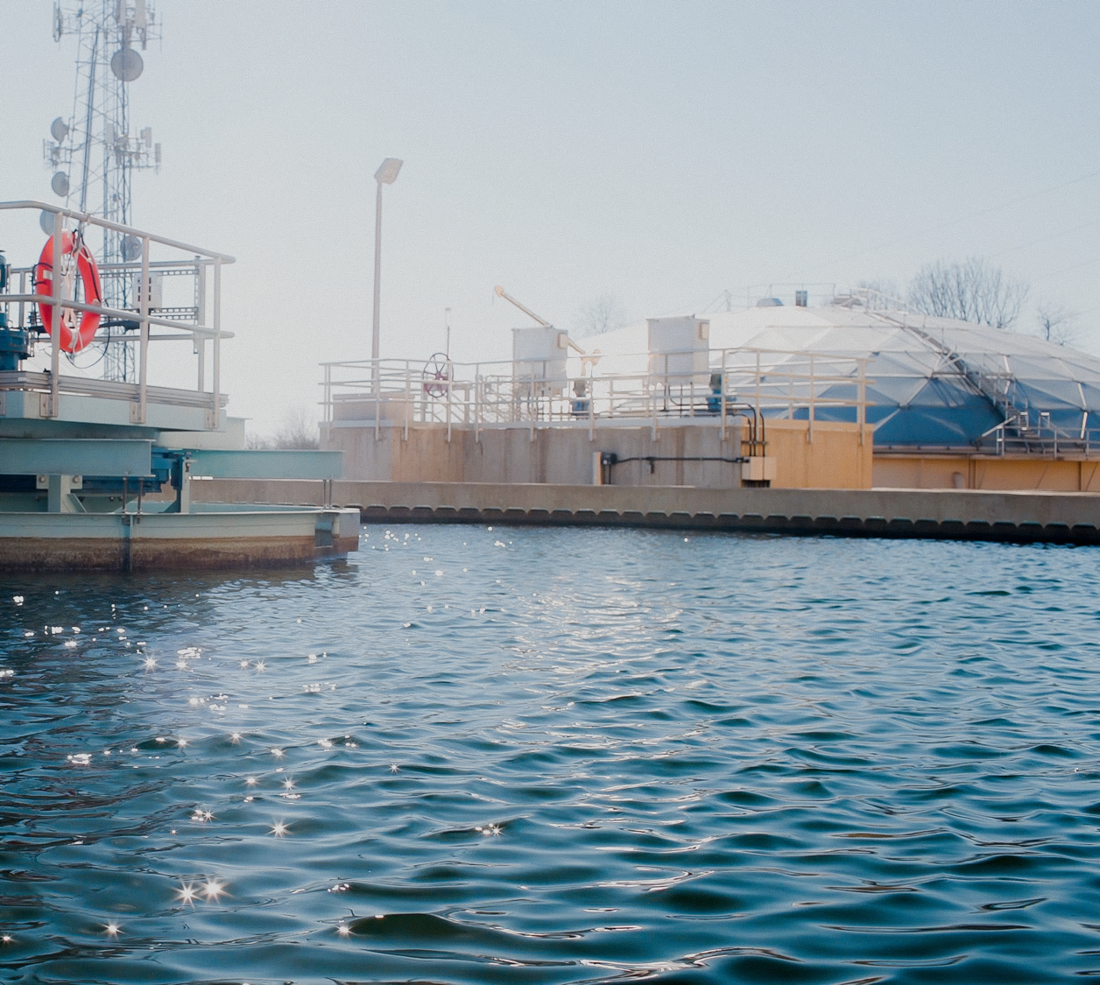
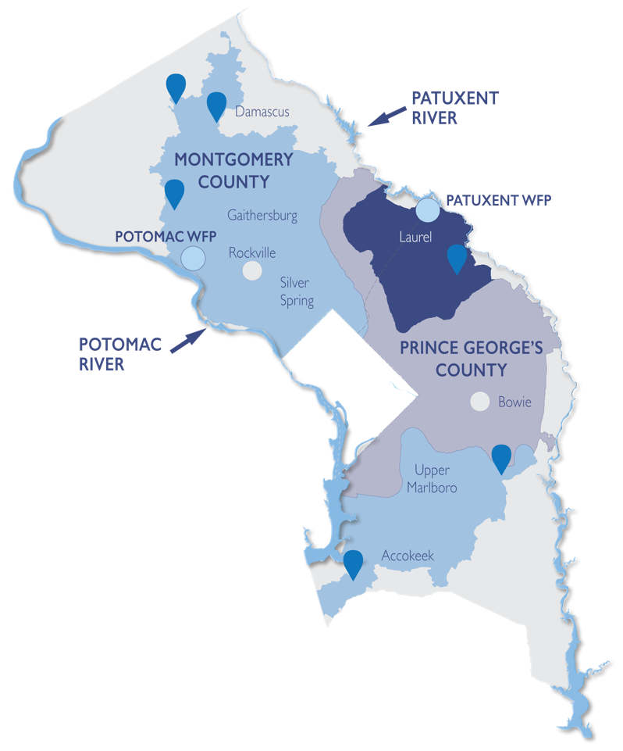
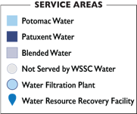
WSSC WATER
AT A GLANCE
106 years of no drinking water quality violations, ever.
1.9M
Residents
served
8th
Largest water utility
in the United States
162 MGD
Water provided
each day
1000 Sq. Miles
Size of WSSC Water’s
Service Area
$114.9B
WSSC Water supports the economic output of Prince George’s and Montgomery counties
1,700+
Members of Team H₂O deliver on our mission
$1.8B
FY2025 Operating & Capital Budget
$5.9B
6-Year Capital Improvements Program
$9B
In infrastructure assets maintained on behalf of our customers

Slide 7
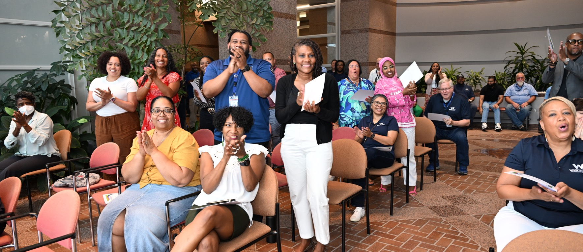
FY 2025-2027 Strategic Plan
A Path Toward Our Smart One Water Future
Notes:
Commissioners, as you know, we released our Strategic Plan for FY 25-27 earlier this month.
We call it our North Star, which will guide us toward innovation, transformation and excellence.
The great thing about this plan is that Team H₂O developed it.
More than 145 team members from across our organization came together and spent countless hours conducting workshops, surveys and interviews to create this living document.
Bob Maloney, director of the general manager's office of performance and accountability, helped lead this effort.
I asked Bob to join me this morning to summarize the plan and the vital role so many members of Team H₂O played in bringing this plan to life.
Bob…

Slide 8






Strategic Plan Development
7
Month journey in developing the plan, including interviews, workshops, working sessions and surveys
145+
Strategic Plan Development Team (SPDT) members created the plan
98
Responses to the survey for input on the layout and cover of the draft plan
550+
Comments on the plan during the review by the SPDT, Planning & Logistics Team and Team H₂O
Notes:
Bob Speaks

Slide 9










Strategic Plan for
Our Smart One Water Future
Vision
Workforce Development & Culture
Affordable
& Financial Viability
In every home, in every business, we make everything possible by ensuring access to dependable and safe water for everyday life.
Smart One Water Mission
Asset Management
& Infrastructure Reliability
Customer Engagement
& Partnerships
WSSC Water ensures all communities thrive by ethically delivering safe, reliable and sustainable water and wastewater services.
Strategic Priorities
Promise
Justice, Equity, Diversity & Inclusion
Sustainability
& Resiliency
Continue the legacy of treasuring our water, customers and employees through dedicated service for current and future generations.
Optimizing Operation
Digital Transformation
Values
Just. Accountable. Caring.
Community-Focused. Excellent. Trustworthy.
34 Objectives to Navigate Team H₂O to Our Smart One Water Future
Notes:
[After Bob finishes]
Thank you, Bob.
Commissioners, your were instrumental in helping bring this plan to life.
Your feedback, guidance and leadership helped us create a document that will guide us on a path of continued growth and transformation.
It is my honor to ask for a vote to adopt our Fiscal Year 2025 – 2027 Strategic Plan through Resolution 2024-2375.
[After vote]
Thank you again, Commissioners.

Slide 10
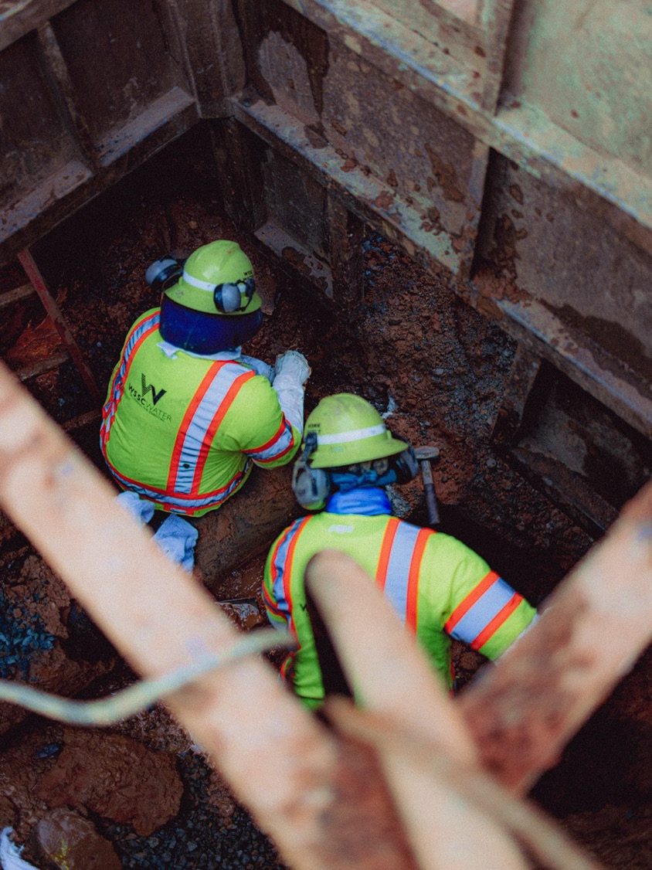
Total Budget – FY25 Approved

Slide 11
FY 2025 Revenue - Where The Money Comes From
Miscellaneous
Rockville Sewer Use, Plumbing and Inspection, Miscellaneous, and interest income
Variable – service use, and interest rate
Fixed Fees
Administrative Maintenance and Infrastructure Investment Fees
Operating Revenue
Where the money comes from
80 cents or 80% of revenue is generated from volumetric charges
Volumetric Charges
Water and Sewer usage, and House Connections/ Front Foot
Variable – water consumption and sewer use

Slide 12
Cost Drivers
FY 2025 Revenue - Where The Money Goes
Operations & Maintenance
Operations and maintenance for facilities (Including share of Blue Plains)
Fixing broken or leaking pipes and repairing roads
Heat, light and power for facilities
Maintaining vehicles and equipment
Customer service
Corporate finance
IT services
Support Services
Salaries and wages
Employee benefits
Employee trainings
Capital Financing
Debt payments and cash for the construction of pipes and facilities
41 cents or 41% of costs are due to capital project financing
  Non-discretionary
Over 52% of costs are fixed

Slide 13
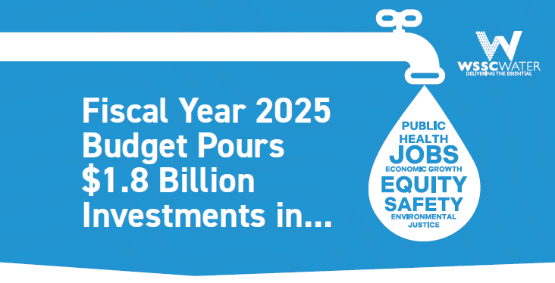
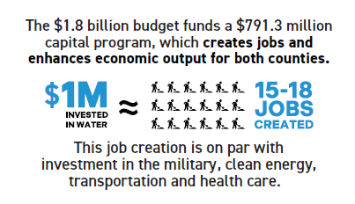
Capital Investments
Investing in critical infrastructure enables WSSC Water to maintain compliance with the Safe Drinking Water and Clean Water Acts. Our robust Capital Improvements Program also creates jobs and enhances the economic output of both counties. For every $1 million invested in water, 15-18 jobs are created.
Investing back into the communities
600+ active projects in planning, design, or construction
165 active construction projects in communities across both counties
  Water mains
  Meter vaults
  Sewer Collection System

Slide 14
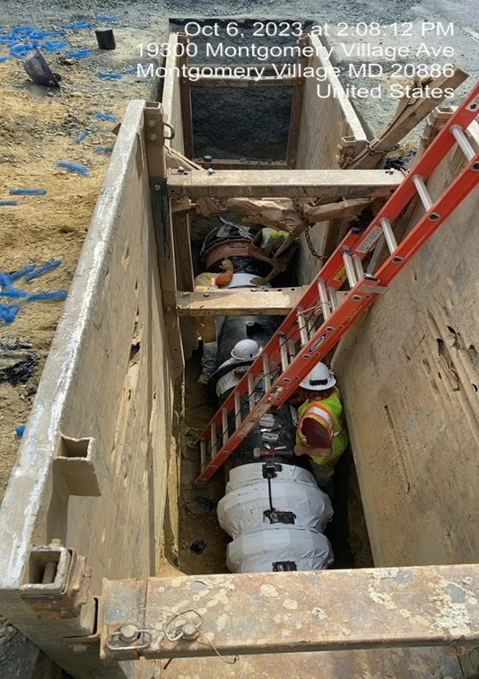
Impact on Municipalities and Customers
Traffic Impacts
Possible temporary changes to traffic patterns
Access will be maintained to homes during construction
Parking Restrictions
48-hour advance notice for (denoted by “No Parking” signs)
Vehicles that have not been removed will be towed to a nearby street at no cost to the owner.
Closeout/Project Restoration
  Temporary/permanent patching of roads
  Mill and overlay and final striping
  Sidewalk and curb restoration
  Greenspace restoration

Slide 15
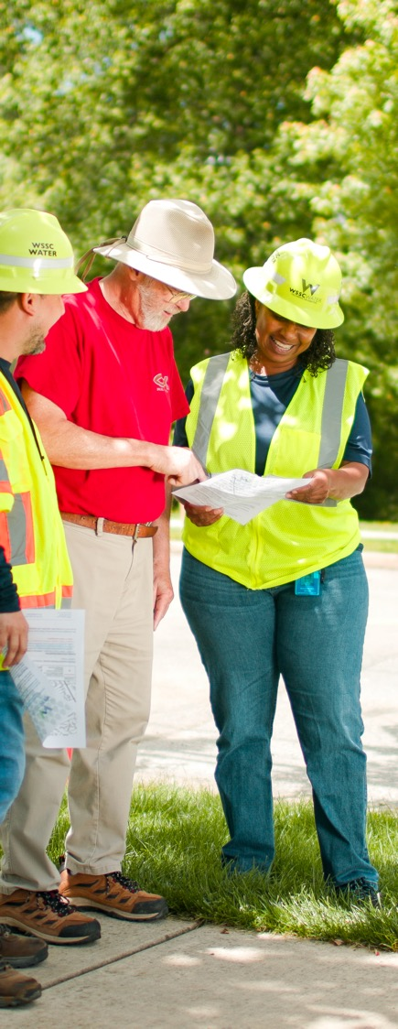

Project Outreach Timeline
Design Phase
1 to 2 Years
Ahead of
Construction Start
Door Hangers
Provide information
about early site work
Notification Letters
Sent when improvement project
is 70 - 90 percent designed
Upcoming Construction
8 to 10 Weeks
Ahead of
Construction Start
Project Construction Start Letter
Friendly reminder that construction
will begin in the coming weeks
Community Meeting(s)
Opportunity for customers to learn
about project details and provide input
Postcard Invite & Social Media
Provide virtual and in-person
community meeting details
Construction Begins
During Construction
and 48 to 72 Hours
Ahead of Impacts
Project Signs
Posted in visible areas with
WSSC Water contact information
Notices to Customers
Information on
construction-related impacts
Post Construction
2 Weeks
After Community
Project Ends
Appreciation & Feedback
Thank you letter and survey
to gauge project satisfaction
Scan or visit
wsscwater.com/projectmeetings
for more information on
Community Project Meetings
Timeline may vary depending on project scope.

Slide 16


Helping Our Neighbors:
Water Bill Assistance
CUSTOMER ASSISTANCE
PROGRAM (CAP)
Sign up for an affordable,
flexible and interest-free
payment plan. Customers
with a past-due balance of $50 or more are eligible.
CAP assists approved residential customers by waiving fixed fees, providing free annual plumbing inspections for water leaks and much more.
Eligible customers can access the Water Fund multiple times, up to $500 per year.
Provides a loan up to $10,000 to finance the repair, replacement or diagnostics of sewer or water on-property service line. The WSSC Federal Credit Union administers PipeER.
wsscwater.com/assistance

Slide 17
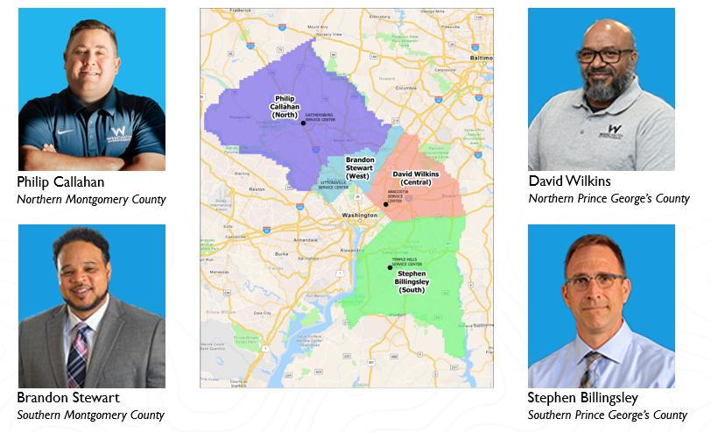
Fab Four: Customer Service Advocates
Liaisons between commercial and residential customers, public officials, county agencies, HOAs/civic associations, other key external stakeholders
Work directly with customers to resolve escalated matters
Attend homeowner association meetings, festivals, town halls and symposiums to meet customers where they live
Educate customers on financial assistance, leaks, water conservation, and other important initiatives
As a team, coordinate on-the-scene customer support during emergency events
Notes:
And when it comes to outstanding service, four people who immediately come to mind are our Customer Service Advocates.
Steve Billingsley, Phil Callahan, Brandon Stewart and David Wilkins are the real deal!
These gentlemen are out there every day -and I’m talking evenings and weekends, too - serving as liaisons between our customers, public and county officials, civic associations and other key stakeholders.
They work their magic resolving problems that have escalated beyond a conversation with our Call Center.
By bringing together our subject matter experts and external stakeholders, they are able to keep our customers happy and get them the results they need.
These fab four are busy and work long days. They attend homeowner association meetings, festivals and town halls so they can meet the customers where they live and help educate them about financial services, toilet leaks, water conservation, construction projects and other critical WSSC Water initiatives.
They’re also the same people you see “on the scene” providing customer support during emergency events – from setting up water stations for customers without water during major water main repairs to, as was the case with Steve, providing customers with assistance after that sewer leak on the DC/MD line back in January.
I know all of Team H2O are wonderful, but I wanted to take a moment to give special thanks to these four wonderful workers – who truly work wonders for WSSC Water!
So let’s give them a round of applause! [Dave Wilkins unable to attend – he’s in training]

Slide 18
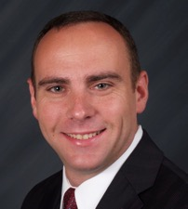

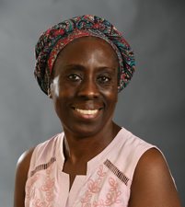
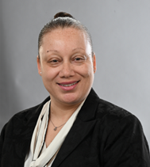
Customer Service
John Curry
Customer Service Director
301-206-8090
John.Curry@wsscwater.com
Contact Us: (301) 206-4001 customerservice@wsscwater.com
What can we help you with?
Start/Stop Service
Understanding Your Bill
Understanding Your Usage
Bill Payment
Payment Plans
Financial Assistance
Mpande Musonda-Langley
Customer Service Deputy Director
301-206-8207
Mpande.Musonda-Langley@wsscwater.com
Zenobia Burns
Customer Care Division Manager
301-206-8762
Zenobia.Burns@wsscwater.com

Slide 19


Customer Notification System (CNS)
Report Water/Sewer Emergency

Slide 20
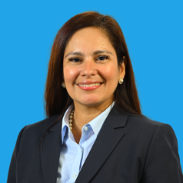
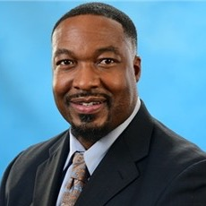
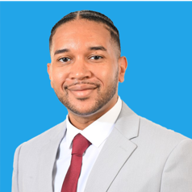
IRO Contacts
Monica Marquina
Government Affairs Director
301-206-8568
Monica.Marquina@wsscwater.com
Thomas Johnson
Government Affairs Manager
301-206-8548
Thomas.Johnson@wsscwater.com
Kenneth Simons
Government Affairs Manager
301-206-8962
Kenneth.Simons@wsscwater.com

Slide 21
Collaboration Opportunities
Share WSSC Water contacts in municipal newsletters and on community listservs
Invite Team H₂0 to participate in community events
Share municipal grant and financial assistance programs
Coordinate with WSSC Water during construction process to keep your residents informed
Reach out – Team H₂O is ready to assist!

Slide 23


